Slide 1
The Platform Inside and Out Release 0.9
Joshua Patterson – GM, Data Science
Notes:
https://rapids.ai/ https://github.com/rapidsai

Slide 2

RAPIDS
End-to-End Accelerated GPU Data Science
Data Preparation
Model Training
Visualization
Dask
cuDF cuIO
Analytics
cuML
Machine Learning
cuGraph
Graph Analytics
PyTorch Chainer MxNet
Deep Learning
cuXfilter <> pyViz
Visualization
GPU Memory

Slide 3
Data Processing Evolution
Faster data access, less data movement
Hadoop Processing, Reading from disk
HDFS Read
Query
HDFS Write
HDFS Read
ETL
HDFS Write
HDFS Read
ML Train
Spark In-Memory Processing
25-100x Improvement
Less code
Language flexible
Primarily In-Memory
HDFS Read
Query
ETL
ML Train
Traditional GPU Processing
5-10x Improvement
More code
Language rigid
Substantially on GPU
HDFS Read
GPU
Read
Query
CPU
Write
GPU
Read
ETL
CPU
Write
GPU
Read
ML
Train

Slide 4

Data Movement and Transformation
Data Movement and Transformation
The bane of productivity and performance
APP B
Read Data
APP B
APP A
GPU Data
APP B
Copy & Convert
CPU
GPU
Copy & Convert
GPU Data
APP A
Copy & Convert
APP A
Load Data

Slide 5
Data Movement and Transformation
Data Movement and Transformation
What if we could keep data on the GPU?
APP B
Read Data
APP B
APP A
GPU Data
APP B
Copy & Convert
CPU
GPU
Copy & Convert
Copy & Convert
GPU Data
APP A
Copy & Convert
APP A
Load Data

Slide 6

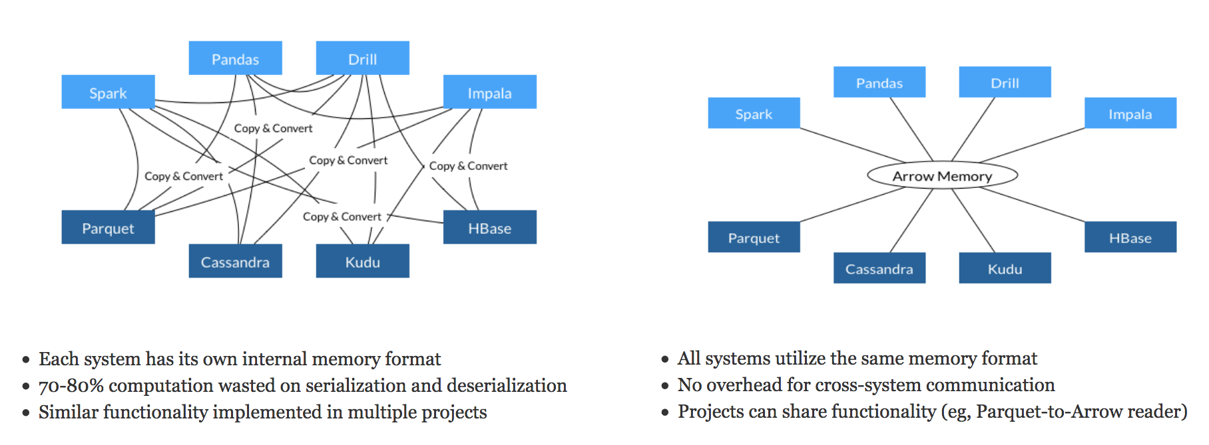
Learning from Apache Arrow
Each system has its own internal memory format
70-80% computation wasted on serialization and deserialization
Similar functionality implemented in multiple projects
All systems utilize the same memory format
No overhead for cross-system communication
Projects can share functionality (eg, Parquet-to-Arrow reader)
From Apache Arrow Home Page - https://arrow.apache.org/
Notes:
But others were discovering this as each system had its own way of handling data. You could use up to 80% of your compute in just copy and conversion

Slide 7
Data Processing Evolution
Faster data access, less data movement
Hadoop Processing, Reading from disk
HDFS Read
Query
HDFS Write
HDFS Read
ETL
HDFS Write
HDFS Read
ML Train
Spark In-Memory Processing
25-100x Improvement
Less code
Language flexible
Primarily In-Memory
HDFS Read
Query
ETL
ML Train
Traditional GPU Processing
5-10x Improvement
More code
Language rigid
Substantially on GPU
HDFS Read
GPU
Read
Query
CPU
Write
GPU
Read
ETL
CPU
Write
GPU
Read
ML
Train
RAPIDS
50-100x Improvement
Same code
Language flexible
Primarily on GPU
Arrow
Read
Query
ETL
ML
Train

Slide 8
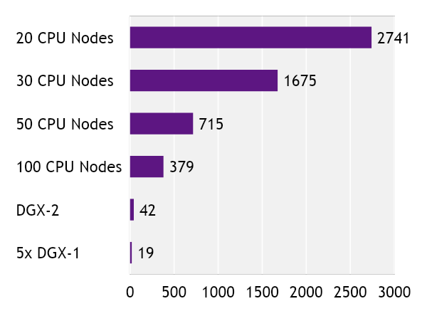
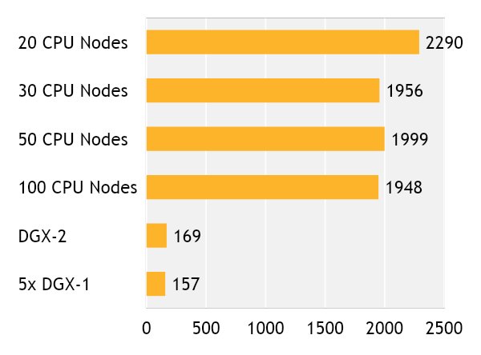
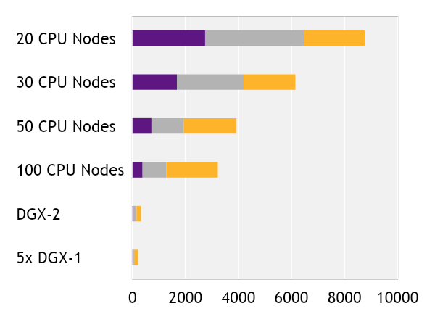
Faster Speeds, Real-World Benefits
cuIO/cuDF –
Load and Data Preparation
cuML - XGBoost
End-to-End
8762
6148
3925
3221
322
213
Time in seconds (shorter is better)
cuIO/cuDF (Load and Data Prep)
Data Conversion
XGBoost
Benchmark
CPU Cluster Configuration
DGX Cluster Configuration
200GB CSV dataset; Data prep includes joins, variable transformations
CPU nodes (61 GiB memory, 8 vCPUs, 64-bit platform), Apache Spark
5x DGX-1 on InfiniBand network

Slide 9
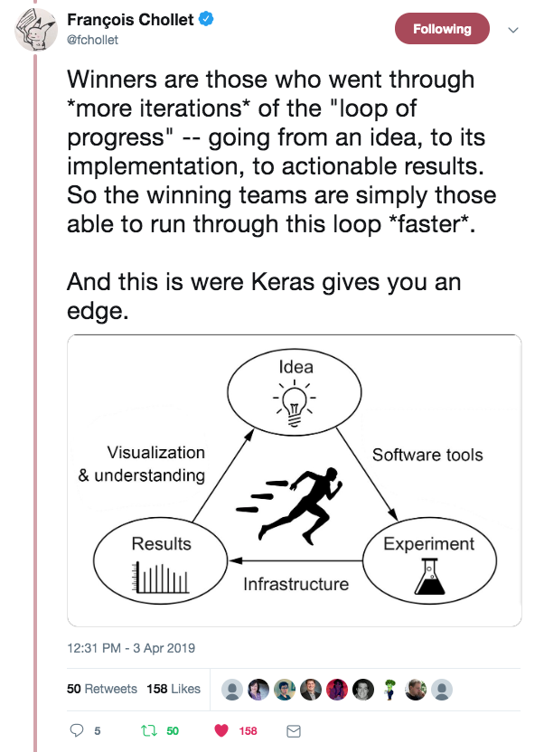
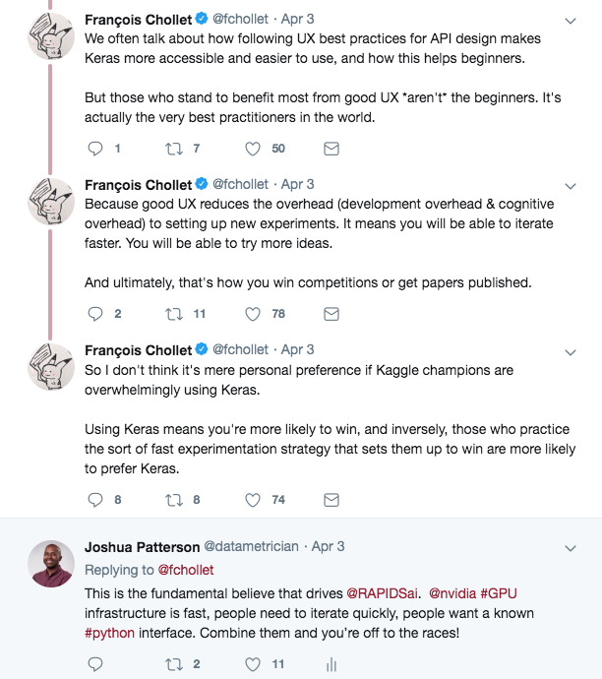
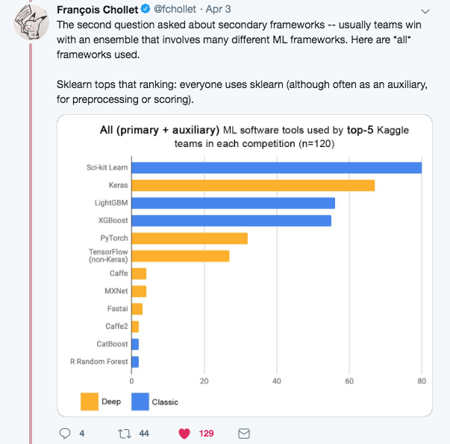

Speed, UX, and Iteration
The Way to Win at Data Science

Slide 10
RAPIDS Core

Slide 11
Open Source Data Science Ecosystem
Familiar Python APIs
Data Preparation
Model Training
Visualization
Dask
Pandas
Analytics
Scikit-Learn
Machine Learning
NetworkX
Graph Analytics
PyTorch Chainer MxNet
Deep Learning
Matplotlib/Seaborn
Visualization
CPU Memory

Slide 12
RAPIDS
End-to-End Accelerated GPU Data Science
Data Preparation
Model Training
Visualization
Dask
cuDF cuIO
Analytics
cuML
Machine Learning
cuGraph
Graph Analytics
PyTorch Chainer MxNet
Deep Learning
cuXfilter <> pyViz
Visualization
GPU Memory

Slide 13
Dask

Slide 14
RAPIDS
Scaling RAPIDS with Dask
Data Preparation
Model Training
Visualization
Dask
cuDF cuIO
Analytics
cuML
Machine Learning
cuGraph
Graph Analytics
PyTorch Chainer MxNet
Deep Learning
cuXfilter <> pyViz
Visualization
GPU Memory

Slide 15

Why Dask?
PyData Native
Easy Migration: Built on top of NumPy, Pandas Scikit-Learn, etc.
Easy Training: With the same APIs
Trusted: With the same developer community
Deployable
Easy Scalability
HPC: SLURM, PBS, LSF, SGE
Cloud: Kubernetes
Hadoop/Spark: Yarn
Easy to install and use on a laptop
Scales out to thousand-node clusters
Popular
Most common parallelism framework today in the PyData and SciPy community

Slide 16

Why OpenUCX?
Bringing hardware accelerated communications to Dask
TCP sockets are slow!
UCX provides uniform access to transports (TCP, InfiniBand, shared memory, NVLink)
Python bindings for UCX (ucx-py) in the works https://github.com/rapidsai/ucx-py
Will provide best communication performance, to Dask based on available hardware on nodes/cluster

Slide 17





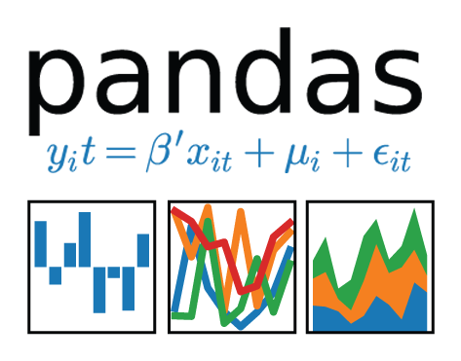
Scale up with RAPIDS
RAPIDS and Others
Accelerated on single GPU
NumPy -> CuPy/PyTorch/..
Pandas -> cuDF
Scikit-Learn -> cuML
Numba -> Numba
Scale Up / Accelerate
PyData
NumPy, Pandas, Scikit-Learn, Numba and many more
Single CPU core
In-memory data

Slide 18

Scale out with RAPIDS + Dask with OpenUCX
RAPIDS and Others
RAPIDS + Dask with OpenUCX
Accelerated on single GPU
NumPy -> CuPy/PyTorch/..
Pandas -> cuDF
Scikit-Learn -> cuML
Numba -> Numba
Multi-GPU
On single Node (DGX)
Or across a cluster
Scale Up / Accelerate
PyData
Dask
NumPy, Pandas, Scikit-Learn, Numba and many more
Single CPU core
In-memory data
Multi-core and Distributed PyData
NumPy -> Dask Array
Pandas -> Dask DataFrame
Scikit-Learn -> Dask-ML
… -> Dask Futures
Scale out / Parallelize

Slide 19
cuDF

Slide 20
RAPIDS
GPU Accelerated data wrangling and feature engineering
Data Preparation
Model Training
Visualization
Dask
cuDF cuIO
Analytics
cuML
Machine Learning
cuGraph
Graph Analytics
PyTorch Chainer MxNet
Deep Learning
cuXfilter <> pyViz
Visualization
GPU Memory

Slide 21
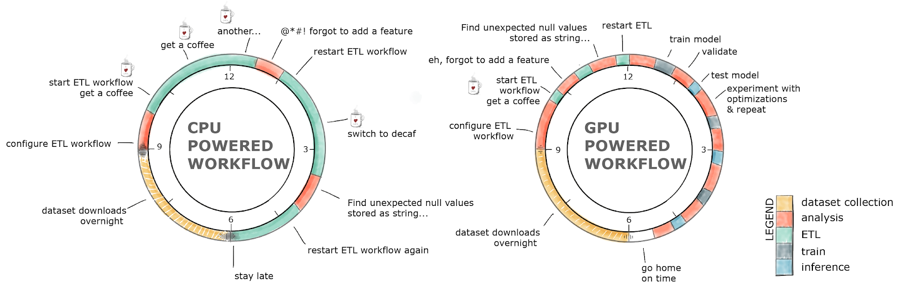
GPU-Accelerated ETL
The average data scientist spends 90+% of their time in ETL as opposed to training models

Slide 22
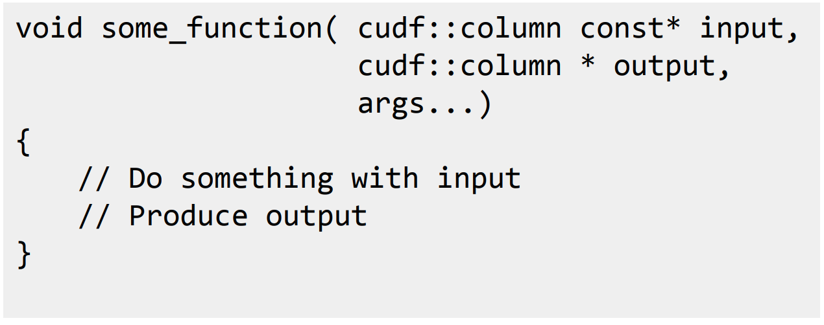



ETL - the Backbone of Data Science
libcuDF is…
CUDA C++ Library
Low level library containing function implementations and C/C++ API
Importing/exporting Apache Arrow in GPU memory using CUDA IPC
CUDA kernels to perform element-wise math operations on GPU DataFrame columns
CUDA sort, join, groupby, reduction, etc. operations on GPU DataFrames

Slide 23
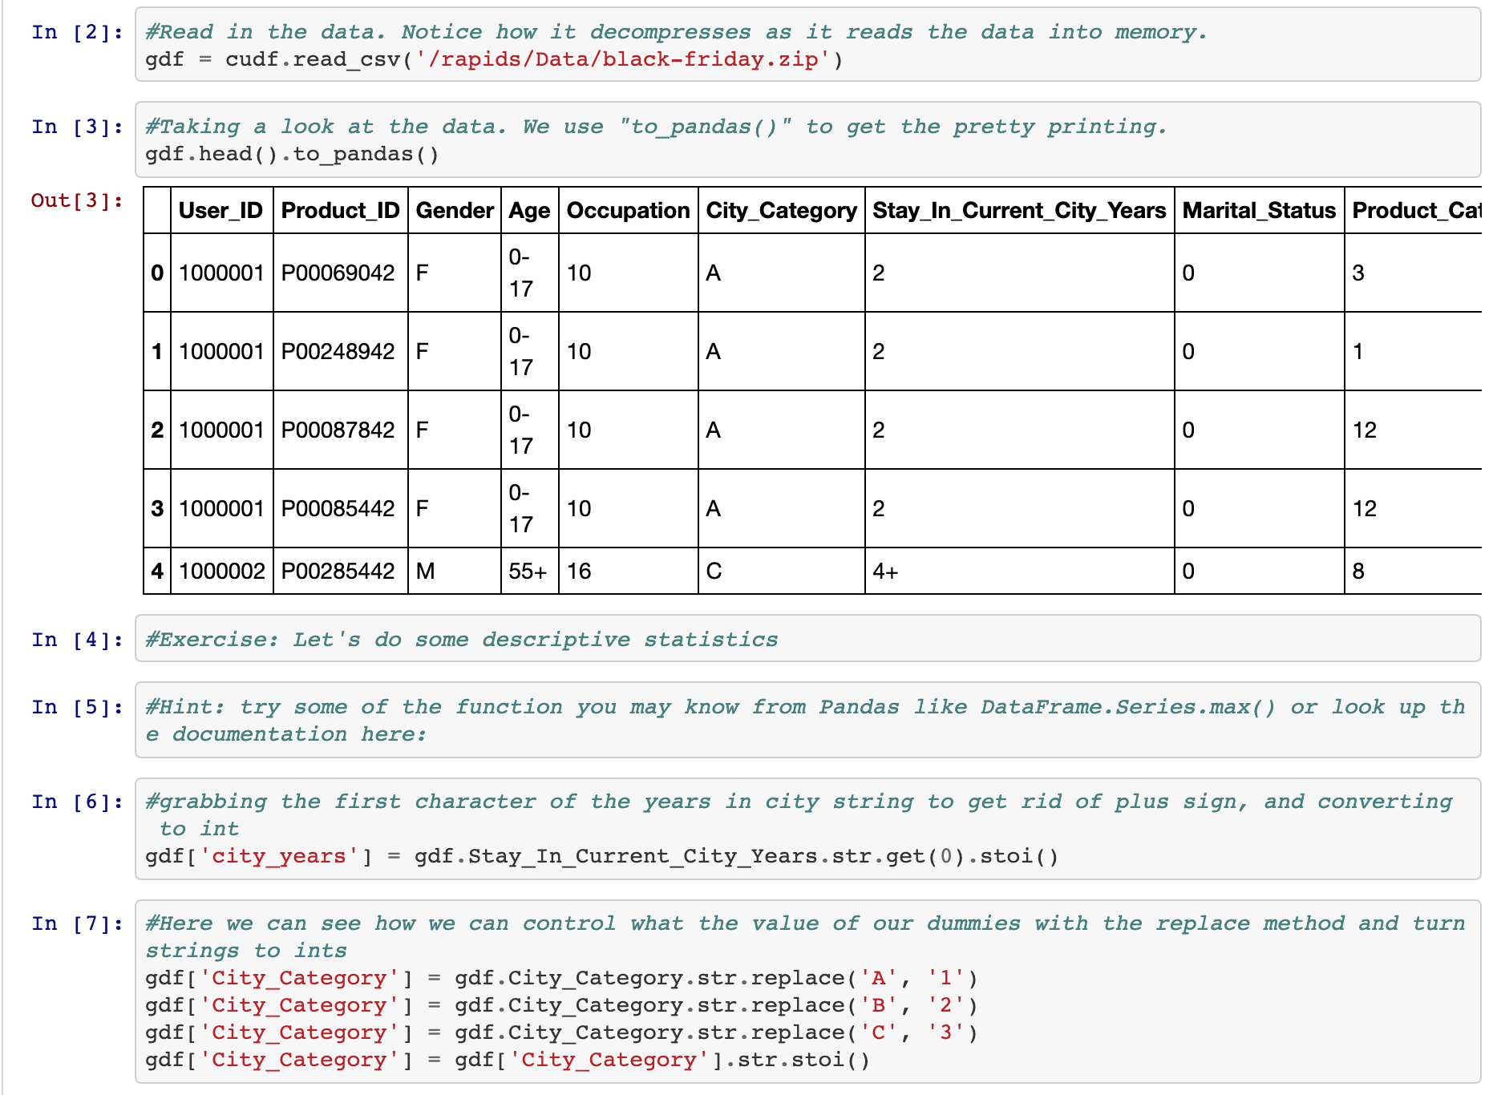
ETL - the Backbone of Data Science
cuDF is…
Python Library
A Python library for manipulating GPU DataFrames following the Pandas API
Python interface to CUDA C++ library with additional functionality
Creating GPU DataFrames from Numpy arrays, Pandas DataFrames, and PyArrow Tables
JIT compilation of User-Defined Functions (UDFs) using Numba

Slide 24
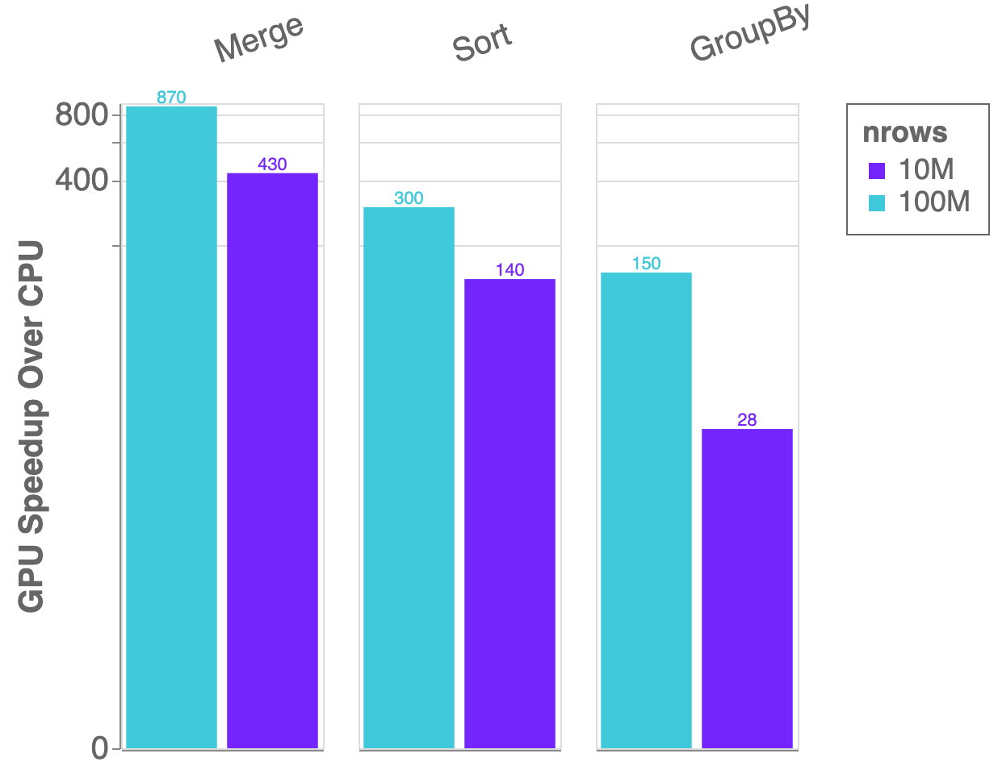
Benchmarks: single-GPU Speedup vs. Pandas
cuDF v0.9, Pandas 0.24.2
Running on NVIDIA DGX-1:
GPU: NVIDIA Tesla V100 32GB
CPU: Intel(R) Xeon(R) CPU E5-2698 v4 @ 2.20GHz
Benchmark Setup:
DataFrames: 2x int32 columns key columns, 3x int32 value columns
Merge: inner
GroupBy: count, sum, min, max calculated for each value column

Slide 25
ETL - the Backbone of Data Science
cuDF is not the end of the story
Data Preparation
Model Training
Visualization
Dask
cuDF cuIO
Analytics
cuML
Machine Learning
cuGraph
Graph Analytics
PyTorch Chainer MxNet
Deep Learning
cuXfilter <> pyViz
Visualization
GPU Memory

Slide 26
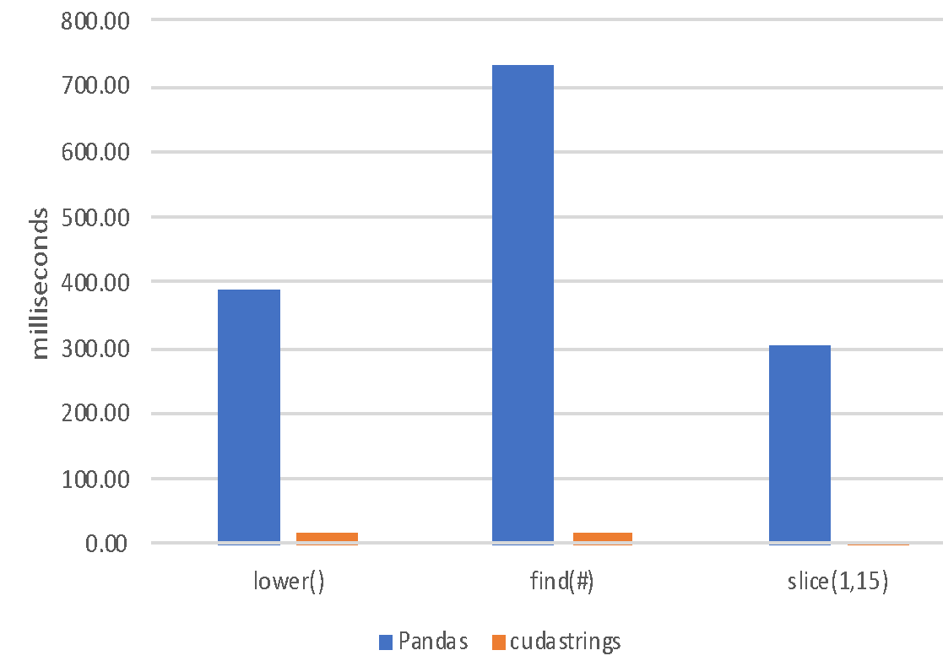
ETL - the Backbone of Data Science
String Support
Current v0.9 String Support
Regular Expressions
Element-wise operations
Split, Find, Extract, Cat, Typecasting, etc…
String GroupBys, Joins
Categorical columns fully on GPU
Future v0.10+ String Support
Combining cuStrings into libcudf
Extensive performance optimization
More Pandas String API compatibility
JIT-compiled String UDFs

Slide 27
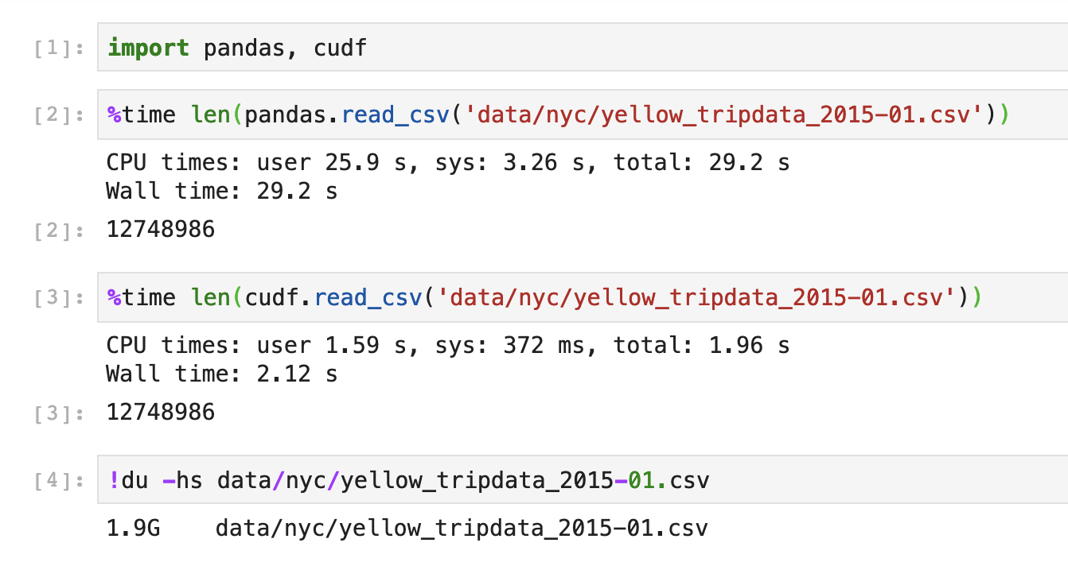
Extraction is the Cornerstone
cuIO for Faster Data Loading
Follow Pandas APIs and provide >10x speedup
CSV Reader - v0.2, CSV Writer v0.8
Parquet Reader – v0.7, Parquet Writer v0.10
ORC Reader – v0.7, ORC Writer v0.10
JSON Reader - v0.8
Avro Reader - v0.9
GPU Direct Storage integration in progress for bypassing PCIe bottlenecks!
Key is GPU-accelerating both parsing and decompression wherever possible
Source: Apache Crail blog: SQL Performance: Part 1 - Input File Formats
Notes:
TSVD – truncated Singular Value Decomposition DBSCAN - Density-Based Spatial Clustering of Applications with Noise

Slide 28
ETL is not just DataFrames!

Slide 29
RAPIDS
Building bridges into the array ecosystem
Data Preparation
Model Training
Visualization
Dask
cuDF cuIO
Analytics
cuML
Machine Learning
cuGraph
Graph Analytics
PyTorch Chainer MxNet
Deep Learning
cuXfilter <> pyViz
Visualization
GPU Memory

Slide 30





Interoperability for the Win
DLPack and __cuda_array_interface__
mpi4py

Slide 31

Interoperability for the Win
DLPack and __cuda_array_interface__
mpi4py

Slide 32

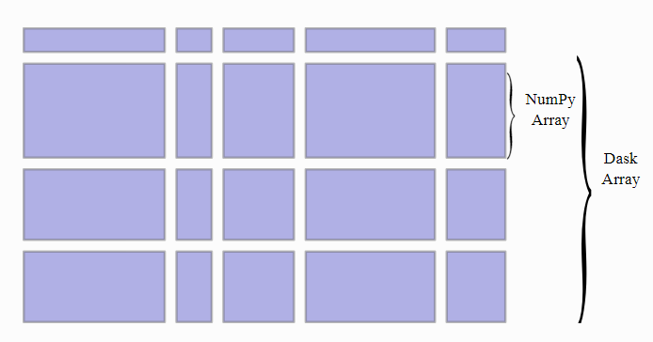
ETL – Arrays and DataFrames
Dask and CUDA Python arrays
Scales NumPy to distributed clusters
Used in climate science, imaging, HPC analysis up to 100TB size
Now seamlessly accelerated with GPUs

Slide 33
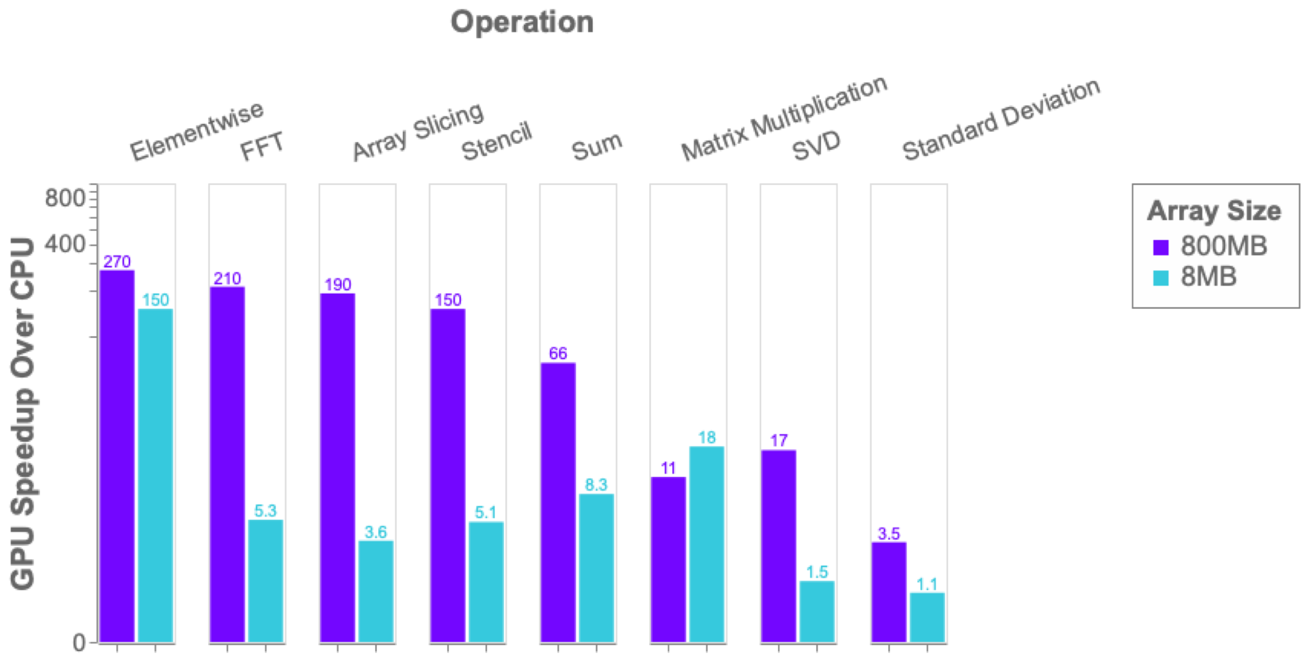
Benchmark: single-GPU CuPy vs NumPy
More details: https://blog.dask.org/2019/06/27/single-gpu-cupy-benchmarks

Slide 34
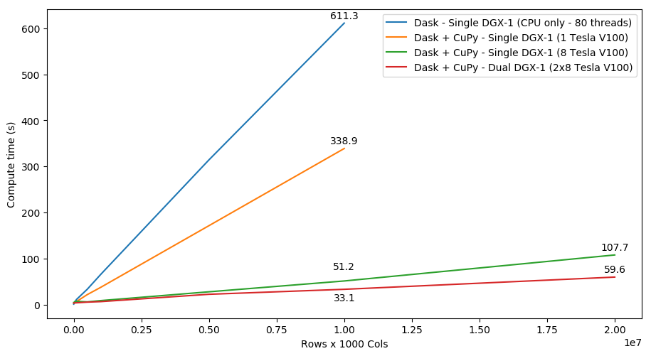
SVD Benchmark
Dask and CuPy Doing Complex Workflows

Slide 35
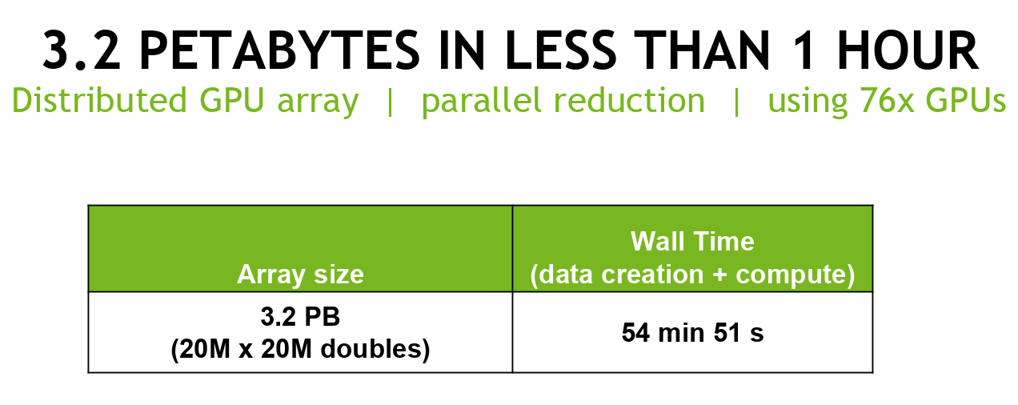
Also…Achievement Unlocked:
Petabyte Scale Data Analytics with Dask and CuPy
Architecture | Time
Single CPU Core | 2hr 39min
Forty CPU Cores | 11min 30s
One GPU | 1min 37s
Eight GPUs | 19s
Cluster configuration: 20x GCP instances, each instance has:
CPU: 1 VM socket (Intel Xeon CPU @ 2.30GHz), 2-core, 2 threads/core, 132GB mem, GbE ethernet, 950 GB disk
GPU: 4x NVIDIA Tesla P100-16GB-PCIe (total GPU DRAM across nodes 1.22 TB)
Software: Ubuntu 18.04, RAPIDS 0.5.1, Dask=1.1.1, Dask-Distributed=1.1.1, CuPY=5.2.0, CUDA 10.0.130
https://blog.dask.org/2019/01/03/dask-array-gpus-first-steps

Slide 36
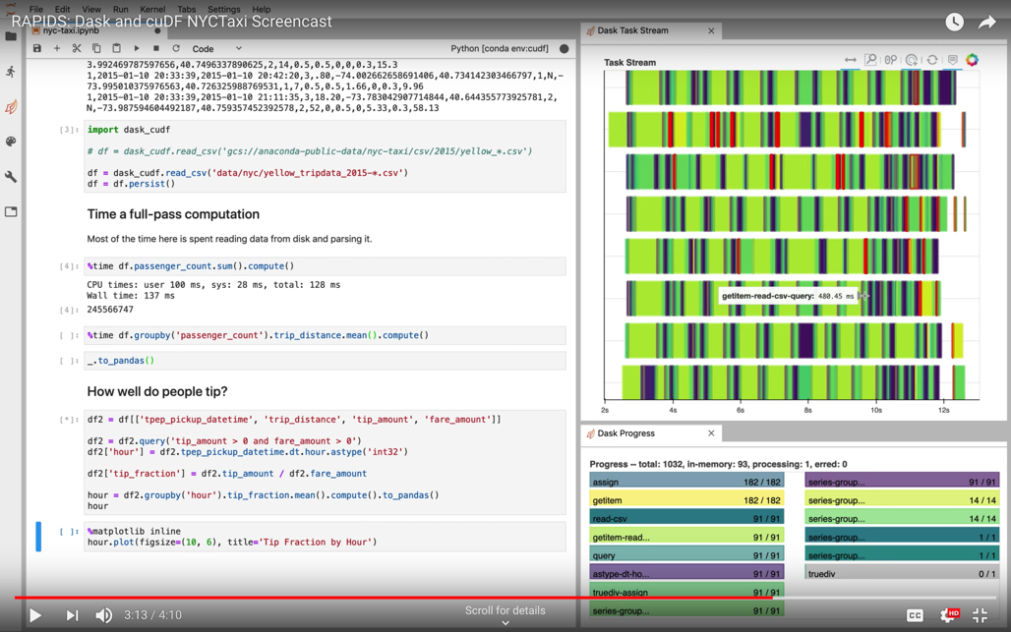
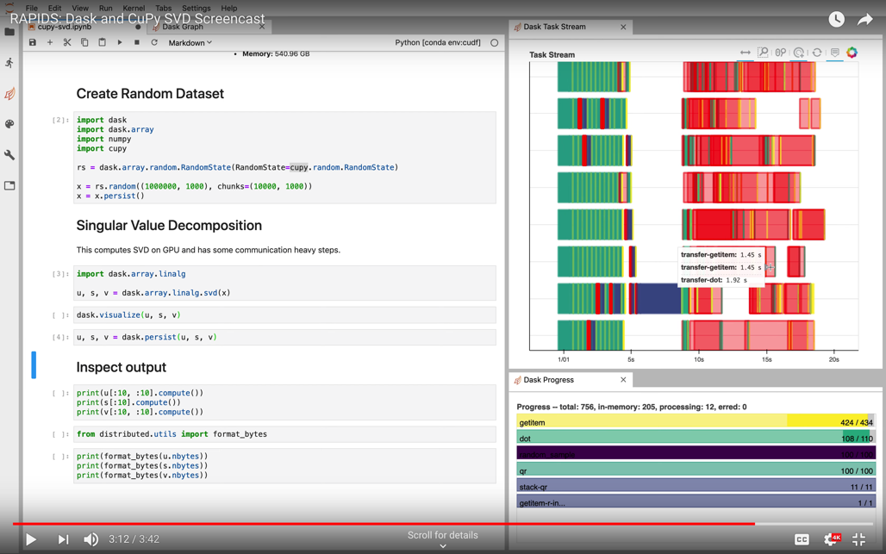
ETL – Arrays and DataFrames
More Dask Awesomeness from RAPIDS
https://youtu.be/gV0cykgsTPM
https://youtu.be/R5CiXti_MWo

Slide 37
cuML

Slide 38
Machine Learning
More models more problems
Data Preparation
Model Training
Visualization
Dask
cuDF cuIO
Analytics
cuML
Machine Learning
cuGraph
Graph Analytics
PyTorch Chainer MxNet
Deep Learning
cuXfilter <> pyViz
Visualization
GPU Memory

Slide 39


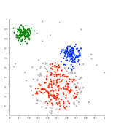
Problem
Data sizes continue to grow
Massive Dataset
Histograms / Distributions
Better to start with as much data as
possible and explore / preprocess to scale
to performance needs.
Dimension Reduction
Feature Selection
Time
Increases
Remove Outliers
Iterate. Cross Validate & Grid Search.
Iterate some more.
Hours? Days?
Sampling
Meet reasonable speed vs accuracy tradeoff
Notes:
Several iterations through our preprocessing, exploration, and training cycle could even take weeks! I’ve been on projects solving complex problems where months would pass before any valuable insight is gained- attributed almost entirely to computation time!

Slide 40
ML Technology Stack
Python
Dask cuML Dask cuDF
cuDF
Numpy
Cython
cuML Algorithms
Thrust
Cub
cuSolver
nvGraph
CUTLASS
cuSparse
cuRand
cuBlas
cuML Prims
CUDA Libraries
CUDA

Slide 41

Algorithms
GPU-accelerated Scikit-Learn
Classification / Regression
Decision Trees / Random Forests
Linear Regression
Logistic Regression
K-Nearest Neighbors
Random forest / GBDT inference
Inference
Clustering
K-Means
DBSCAN
Spectral Clustering
Principal Components
Singular Value Decomposition UMAP
Spectral Embedding
Decomposition & Dimensionality Reduction
Cross Validation
Time Series
Holt-Winters
Kalman Filtering
Hyper-parameter Tuning
Key:
Preexisting
NEW for 0.9
More to come!
Notes:
In the C++ Algorithms side, you'll find full machine learning algorithms such as classification & regression, statistical inference, clustering, dimensionality reduction, timeseries forecasting, & recommendations. We'll have cross validation very soon and much more.

Slide 42
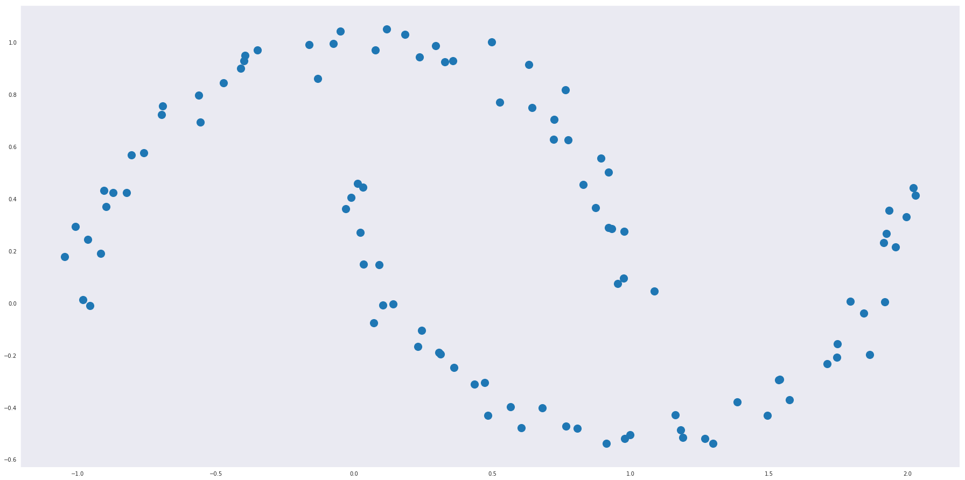
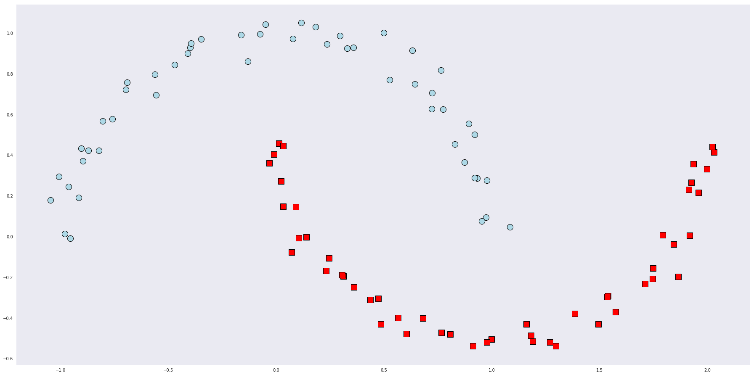
RAPIDS matches common Python APIs
CPU-Based Clustering
from sklearn.datasets import make_moons import pandas
X, y = make_moons(n_samples=int(1e2), noise=0.05, random_state=0) X = pandas.DataFrame({'fea%d'%i: X[:, i] for i in range(X.shape[1])})
Find Clusters
from sklearn.cluster import DBSCAN dbscan = DBSCAN(eps = 0.3, min_samples = 5) dbscan.fit(X) y_hat = dbscan.predict(X)
Notes:
And our resulting clusters.

Slide 43
RAPIDS matches common Python APIs
GPU-Accelerated Clustering
from sklearn.datasets import make_moons import cudf
X, y = make_moons(n_samples=int(1e2), noise=0.05, random_state=0) X = cudf.DataFrame({'fea%d'%i: X[:, i] for i in range(X.shape[1])})
Find Clusters
from cuml import DBSCAN dbscan = DBSCAN(eps = 0.3, min_samples = 5) dbscan.fit(X) y_hat = dbscan.predict(X)
Notes:
And our resulting clusters.

Slide 44
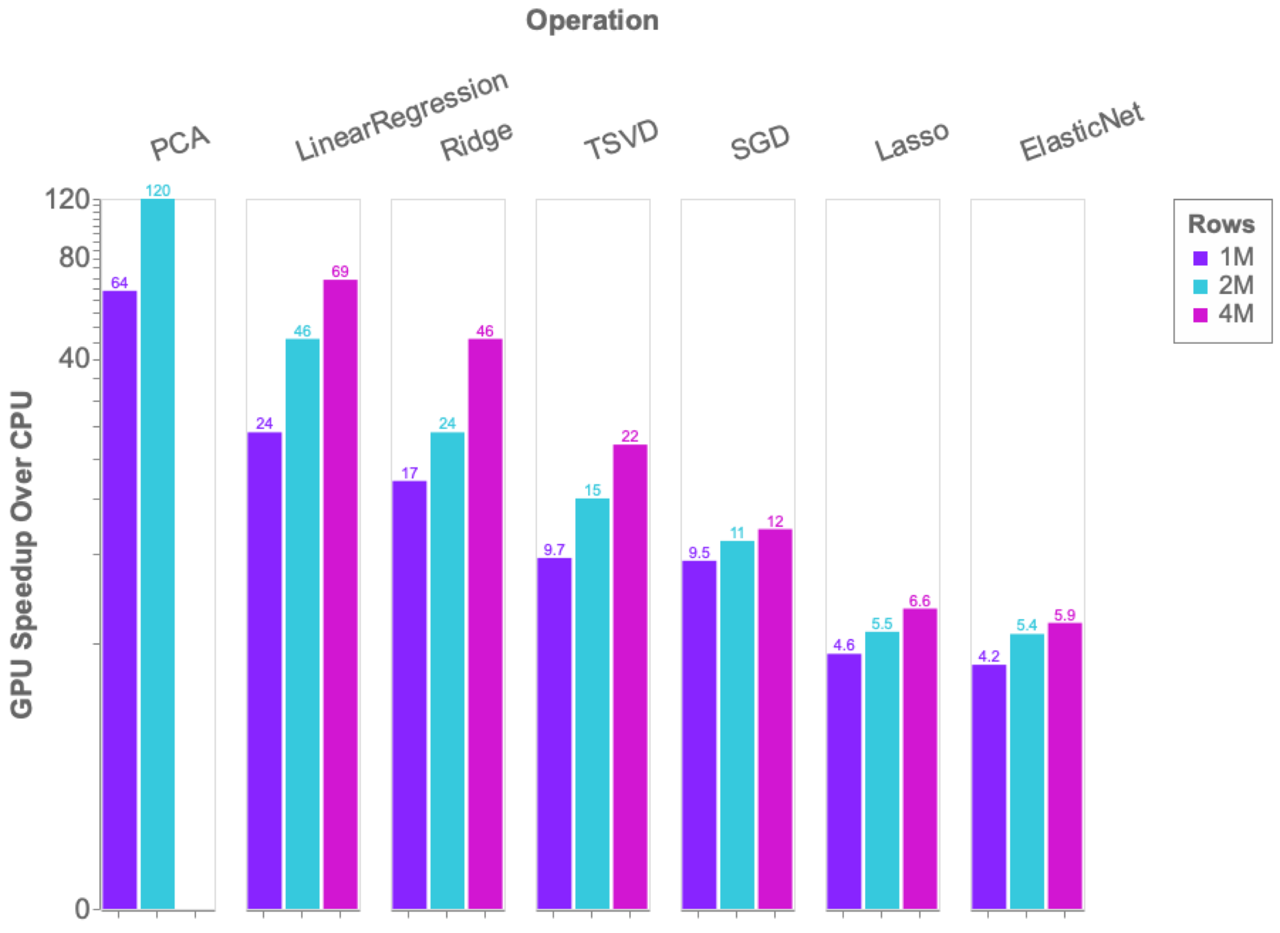
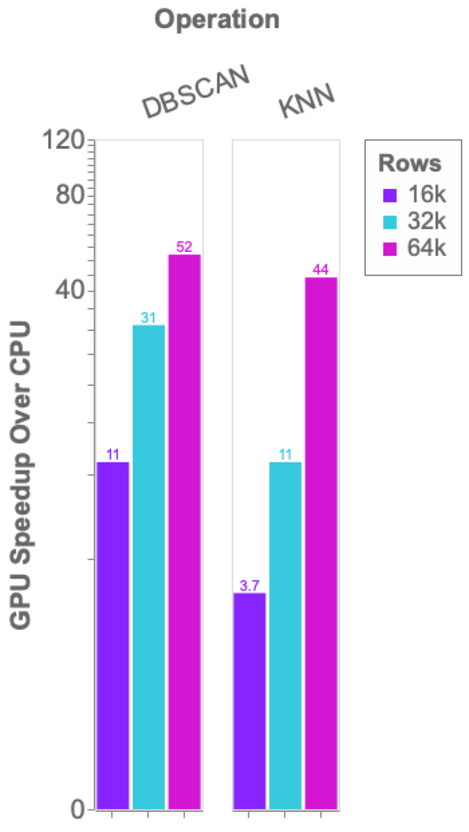
Benchmarks: single-GPU cuML vs scikit-learn
1x V100
vs
2x 20 core CPU

Slide 45
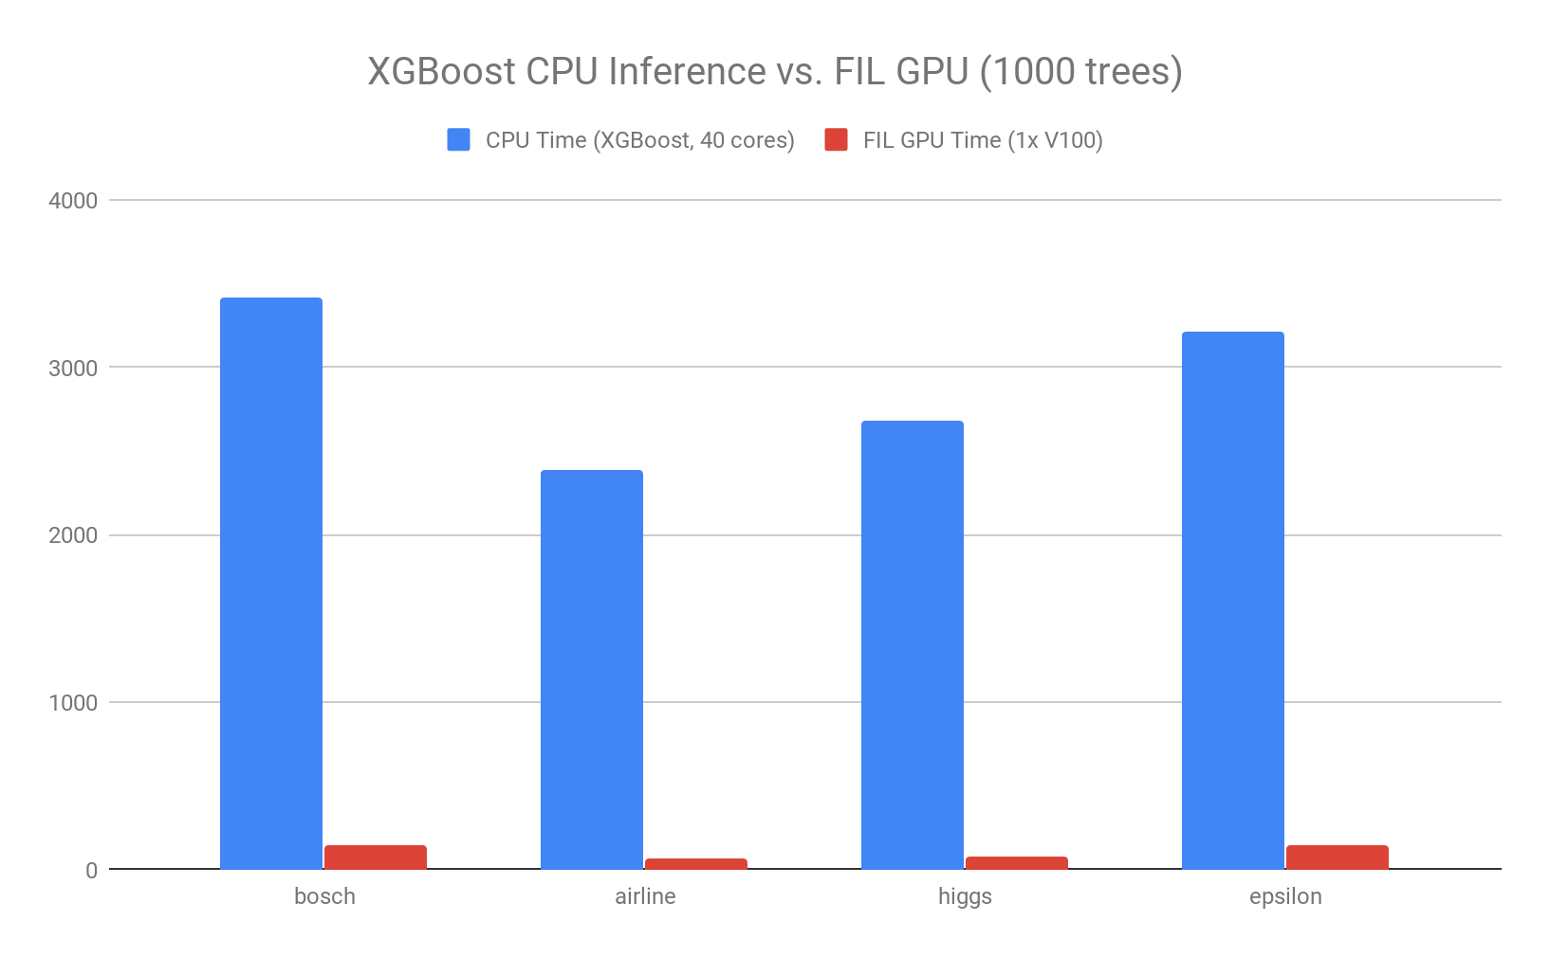
Forest Inference
Taking models from training to production
cuML’s Forest Inference Library accelerates prediction (inference) for random forests and boosted decision trees:
Works with existing saved models (XGBoost and LightGBM today, scikit-learn RF and cuML RF soon)
Lightweight Python API
Single V100 GPU can infer up to 34x faster than XGBoost dual-CPU node
Over 100 million forest inferences per sec (with 1000 trees) on a DGX-1
23x
36x
34x
23x
Notes:
DGX-1, 2x E5-2698 v4 @ 2.20GHz, V100-32GB, using FIL BATCH_REORG algo, 1000 trees, max_depth=10
Trained in XGBoost using data from https://github.com/NVIDIA/gbm-bench
Release 0.9

Slide 46
Road to 1.0
August 2019 - RAPIDS 0.9
cuML | Single-GPU | Multi-GPU | Multi-Node-Multi-GPU
Gradient Boosted Decision Trees (GBDT)
GLM
Logistic Regression
Random Forest
K-Means
K-NN
DBSCAN
UMAP
Holt-Winters
Kalman Filter
t-SNE
Principal Components
Singular Value Decomposition

Slide 47
Road to 1.0
March 2020 - RAPIDS 0.14
cuML | Single-GPU | Multi-GPU | Multi-Node-Multi-GPU
Gradient Boosted Decision Trees (GBDT)
GLM
Logistic Regression
Random Forest
K-Means
K-NN
DBSCAN
UMAP
ARIMA & Holt-Winters
Kalman Filter
t-SNE
Principal Components
Singular Value Decomposition

Slide 48
cuGraph

Slide 49
Graph Analytics
More connections more insights
Data Preparation
Model Training
Visualization
Dask
cuDF cuIO
Analytics
cuML
Machine Learning
cuGraph
Graph Analytics
PyTorch Chainer MxNet
Deep Learning
cuXfilter <> pyViz
Visualization
GPU Memory

Slide 50
GOALS AND BENEFITS OF CUGRAPH
Focus on Features and User Experience
Breakthrough Performance
Multiple APIs
Up to 500 million edges on a single 32GB GPU
Multi-GPU support for scaling into the billions of edges
Python: Familiar NetworkX-like API
C/C++: lower-level granular control for application developers
Seamless Integration with cuDF and cuML
Growing Functionality
Property Graph support via DataFrames
Extensive collection of algorithm, primitive, and utility functions

Slide 51
Graph Technology Stack
Python
Dask cuGraph Dask cuDF
cuDF
Numpy
Cython
cuGraph Algorithms
Prims
cuGraphBLAS
cuHornet
thrust
cub
cuSolver
cuSparse
cuRand
Gunrock*
CUDA Libraries
CUDA
nvGRAPH has been Opened Sourced and integrated into cuGraph. A legacy version is available in a RAPIDS GitHub repo
* Gunrock is from UC Davis

Slide 52
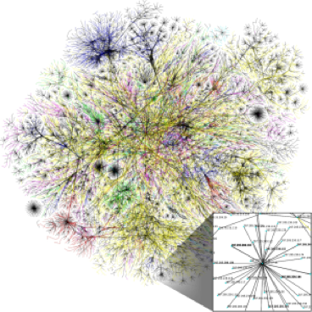
Algorithms
GPU-accelerated NetworkX
Spectral Clustering
Balanced-Cut
Modularity Maximization
Louvain
Subgraph Extraction
Triangle Counting
Community
Components
Weakly Connected Components
Strongly Connected Components
Link Analysis
Page Rank (Multi-GPU)
Personal Page Rank
Query Language
Link Prediction
Jaccard
Weighted Jaccard
Overlap Coefficient
Multi-GPU
Traversal
Single Source Shortest Path (SSSP)
Breadth First Search (BFS)
Utilities
Structure
COO-to-CSR (Multi-GPU) Transpose
Renumbering
More to come!

Slide 53
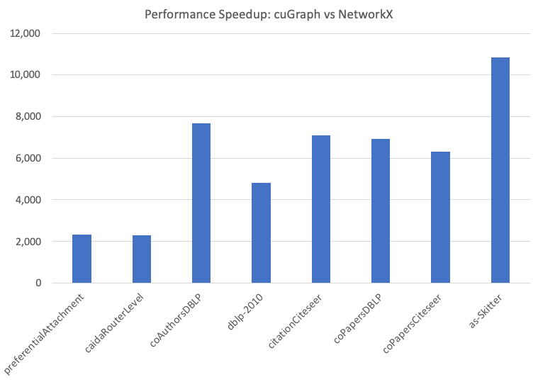
Louvain Single Run
G = cugraph.Graph()
G.add_edge_list(gdf["src_0"], gdf["dst_0"], gdf["data"])
df, mod = cugraph.nvLouvain(G)
Louvain returns:
cudf.DataFrame with two names columns:
louvain["vertex"]: The vertex id.
louvain["partition"]: The assigned partition.
Dataset | Nodes | Edges
preferentialAttachment | 100,000 | 999,970
caidaRouterLevel | 192,244 | 1,218,132
coAuthorsDBLP | 299,067 | 299,067
dblp-2010 | 326,186 | 1,615,400
citationCiteseer | 268,495 | 2,313,294
coPapersDBLP | 540,486 | 30,491,458
coPapersCiteseer | 434,102 | 32,073,440
as-Skitter | 1,696,415 | 22,190,596

Slide 54
Multi-GPU PageRank Performance
PageRank portion of the HiBench benchmark suite
HiBench Scale | Vertices | Edges | CSV File (GB) | # of GPUs | PageRank for 3 Iterations (secs)
Huge | 5,000,000 | 198,000,000 | 3 | 1 | 1.1
BigData | 50,000,000 | 1,980,000,000 | 34 | 3 | 5.1
BigData x2 | 100,000,000 | 4,000,000,000 | 69 | 6 | 9.0
BigData x4 | 200,000,000 | 8,000,000,000 | 146 | 12 | 18.2
BigData x8 | 400,000,000 | 16,000,000,000 | 300 | 16 | 31.8

Slide 55
Road to 1.0
August 2019 - RAPIDS 0.9
cuGraph | Single-GPU | Multi-GPU | Multi-Node-Multi-GPU
Jaccard and Weighted Jaccard
Page Rank
Personal Page Rank
SSSP
BFS
Triangle Counting
Subgraph Extraction
Katz Centrality
Betweenness Centrality
Connected Components (Weak and Strong)
Louvain
Spectral Clustering
InfoMap
K-Cores

Slide 56
Road to 1.0
March 2020 - RAPIDS 0.14
cuGraph | Single-GPU | Multi-GPU | Multi-Node-Multi-GPU
Jaccard and Weighted Jaccard
Page Rank
Personal Page Rank
SSSP
BFS
Triangle Counting
Subgraph Extraction
Katz Centrality
Betweenness Centrality
Connected Components (Weak and Strong)
Louvain
Spectral Clustering
InfoMap
K-Cores

Slide 57
Community

Slide 58
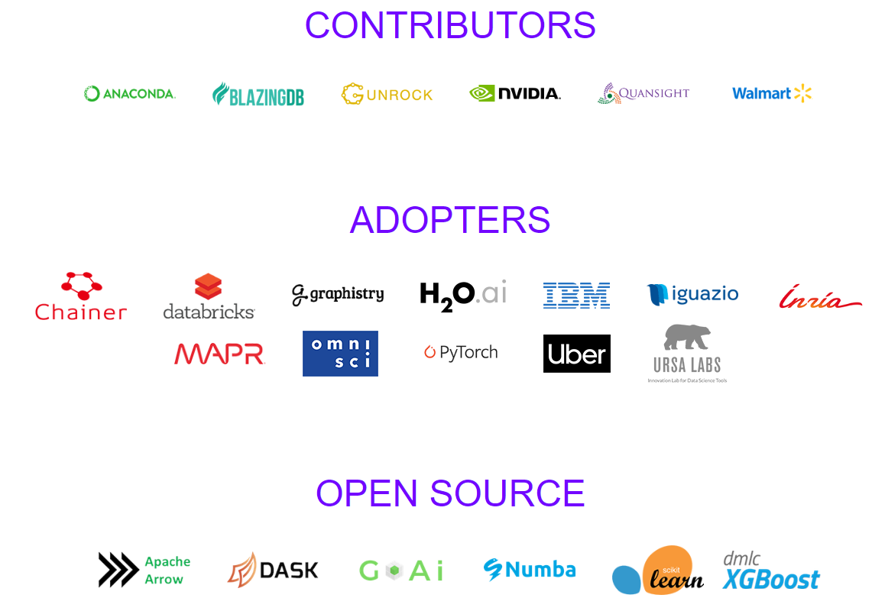
Ecosystem Partners

Slide 59


Building on top of RAPIDS
A bigger, better, stronger ecosystem for all
Streamz
High-Performance Serverless event and data processing that utilizes RAPIDS for GPU Acceleration
GPU accelerated SQL engine built on top of RAPIDS
Distributed stream processing using RAPIDS and Dask

Slide 60







Deploy RAPIDS Everywhere
Focused on robust functionality, deployment, and user experience
Cloud Dataproc
Azure Machine Learning
Integration with major cloud providers
Both containers and cloud specific machine instances
Support for Enterprise and HPC Orchestration Layers

Slide 61
5 Steps to getting started with RAPIDS
Install RAPIDS on using Docker, Conda, or Colab
Join our community conversations on Slack, Google, and Twitter
Explore our walk through videos, blog content, our github, the tutorial notebooks, and our examples workflows,
Build your own data science workflows.
Contribute back. Don't forget to ask and answer questions on Stack Overflow

Slide 62
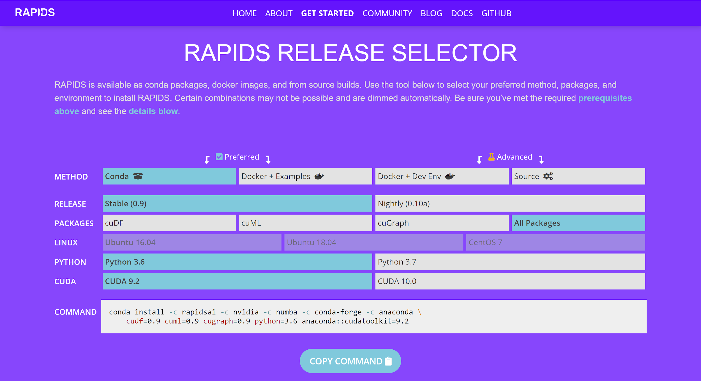
Easy Installation
Interactive Installation Guide

Slide 63

Join the Conversation

Slide 64
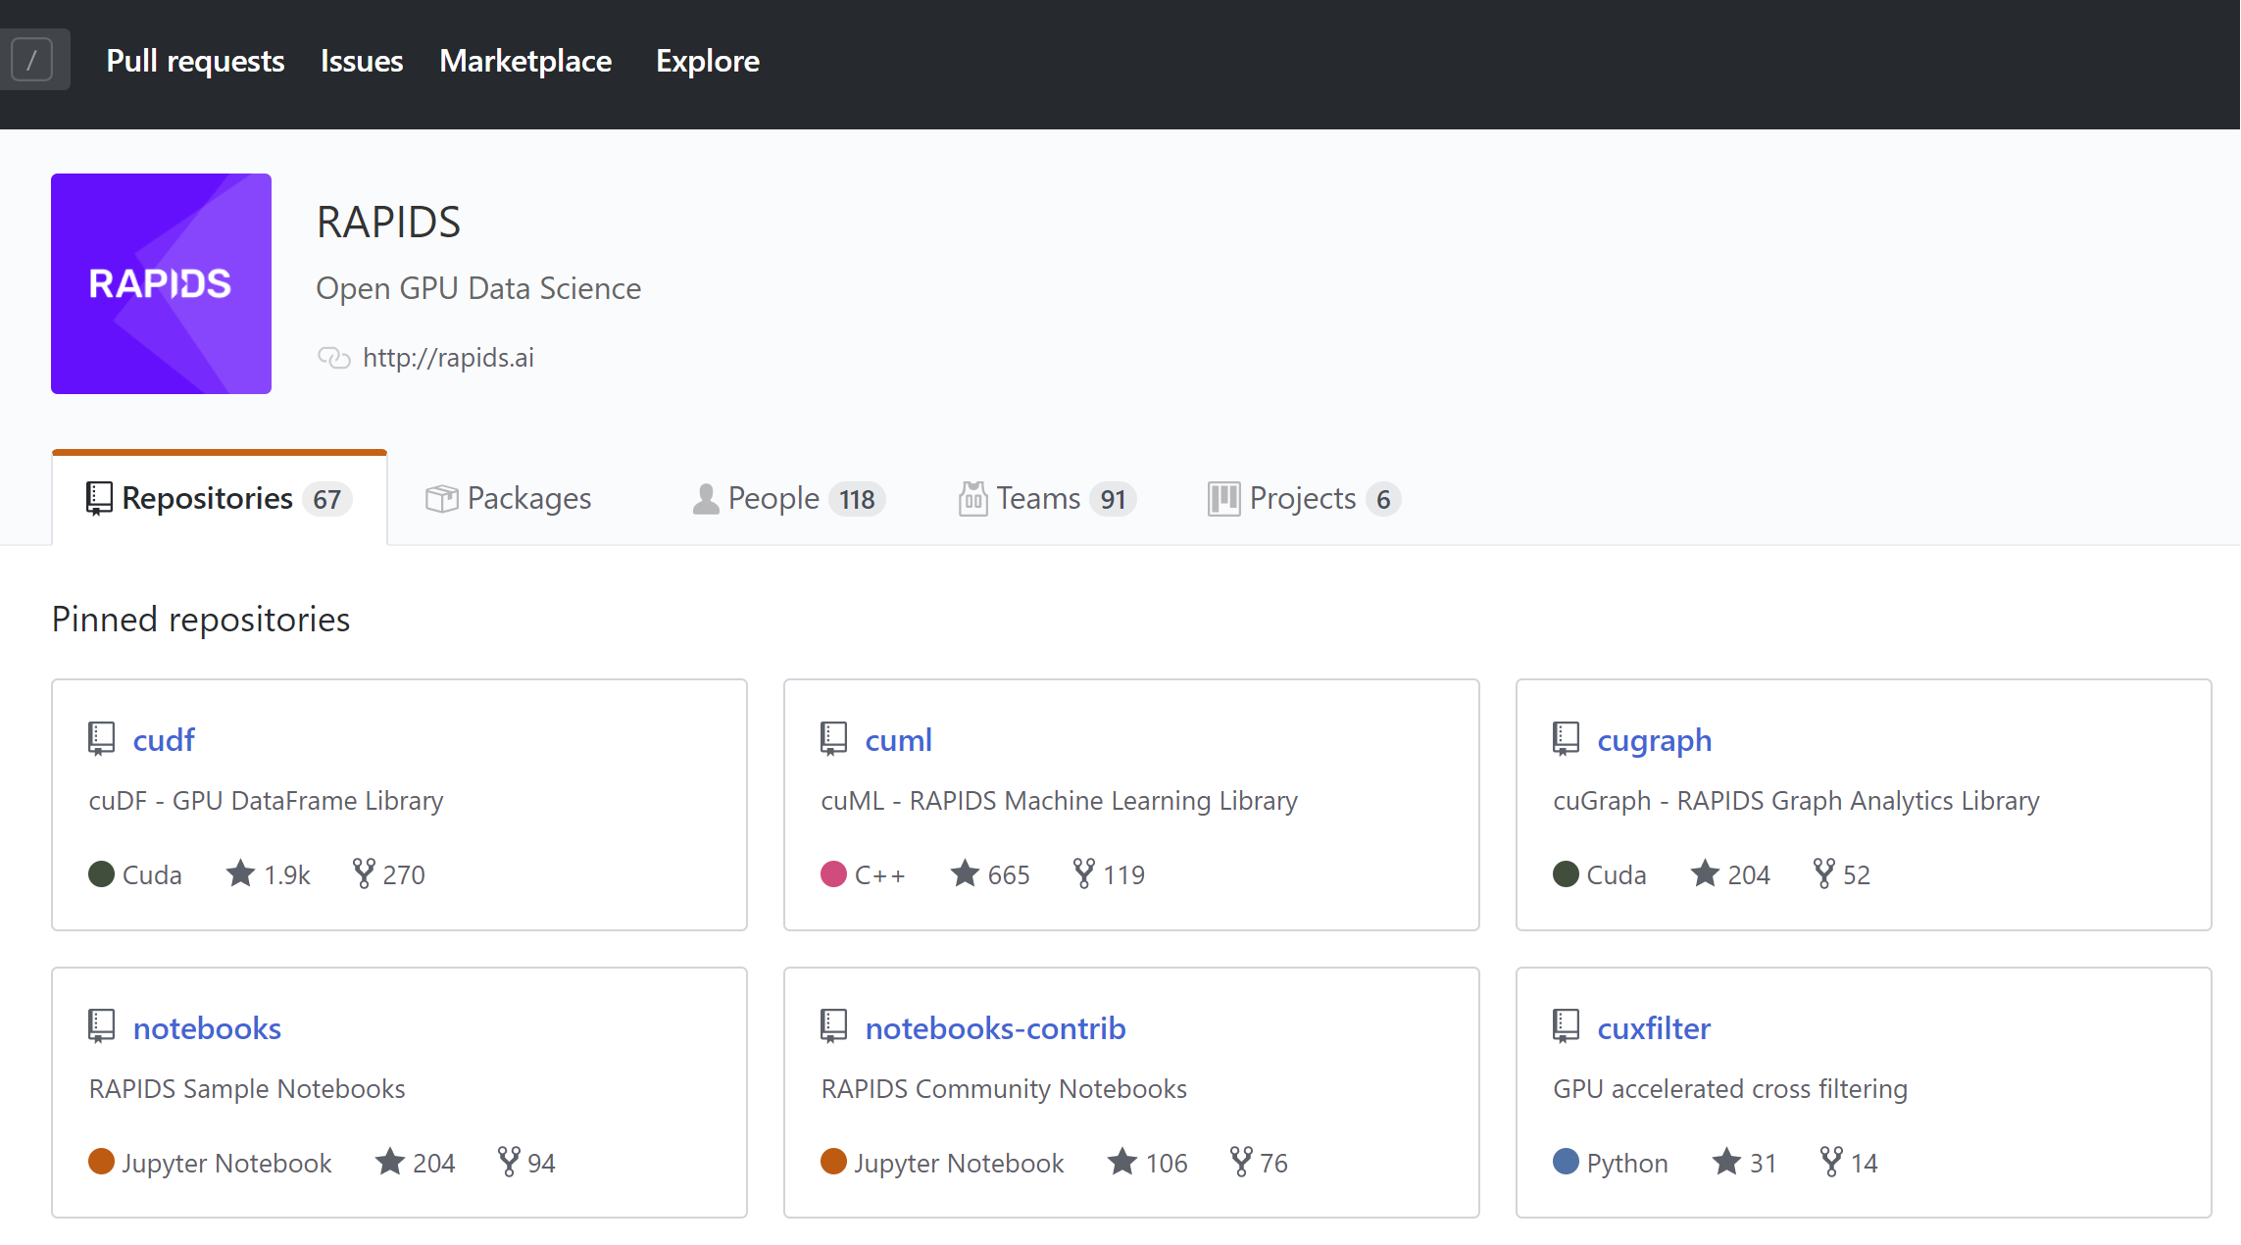
Explore: RAPIDS Github
https://github.com/rapidsai

Slide 65
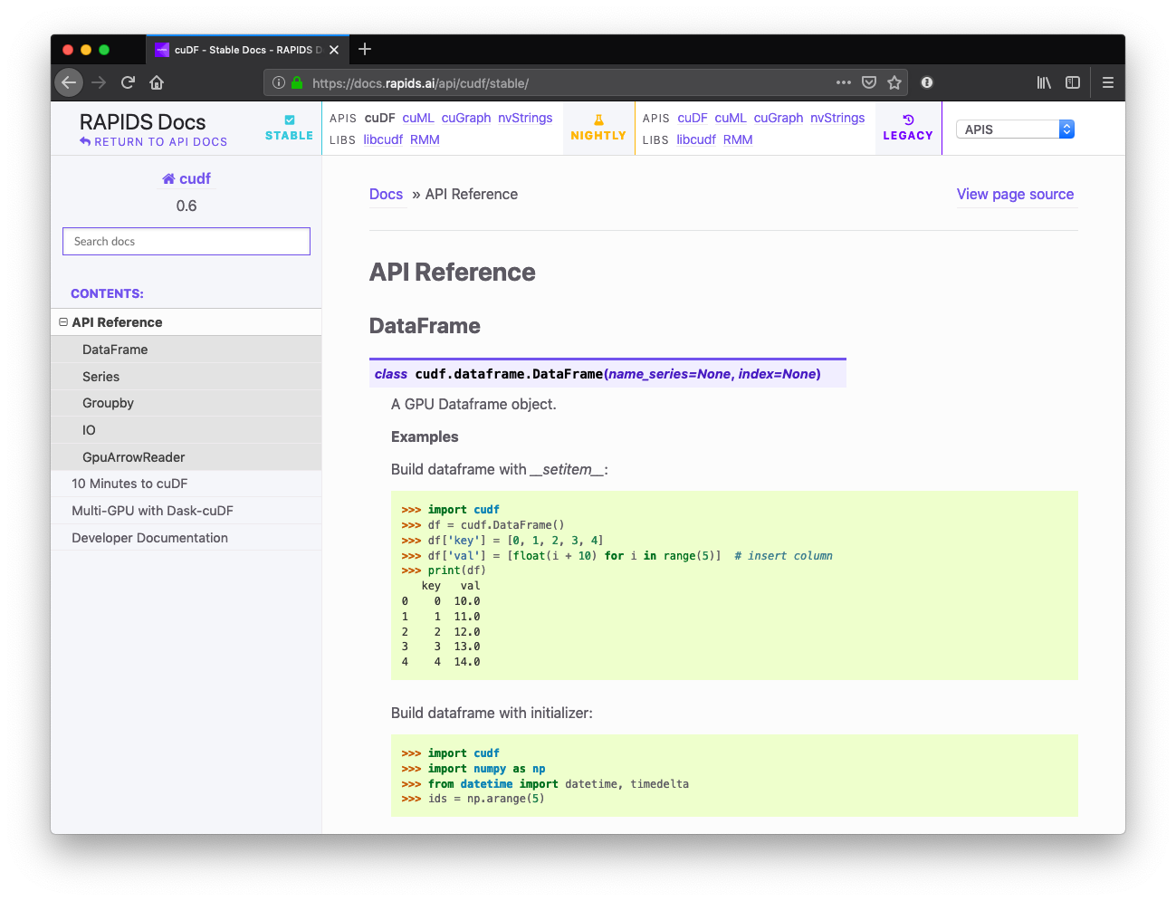
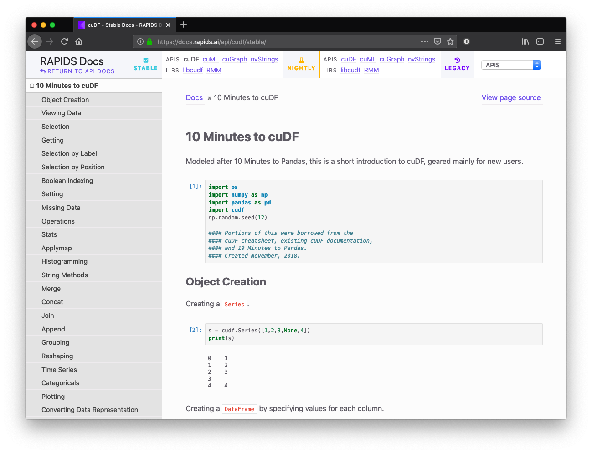
Explore: RAPIDS Docs
Improved and easier to use!
https://docs.rapids.ai

Slide 66
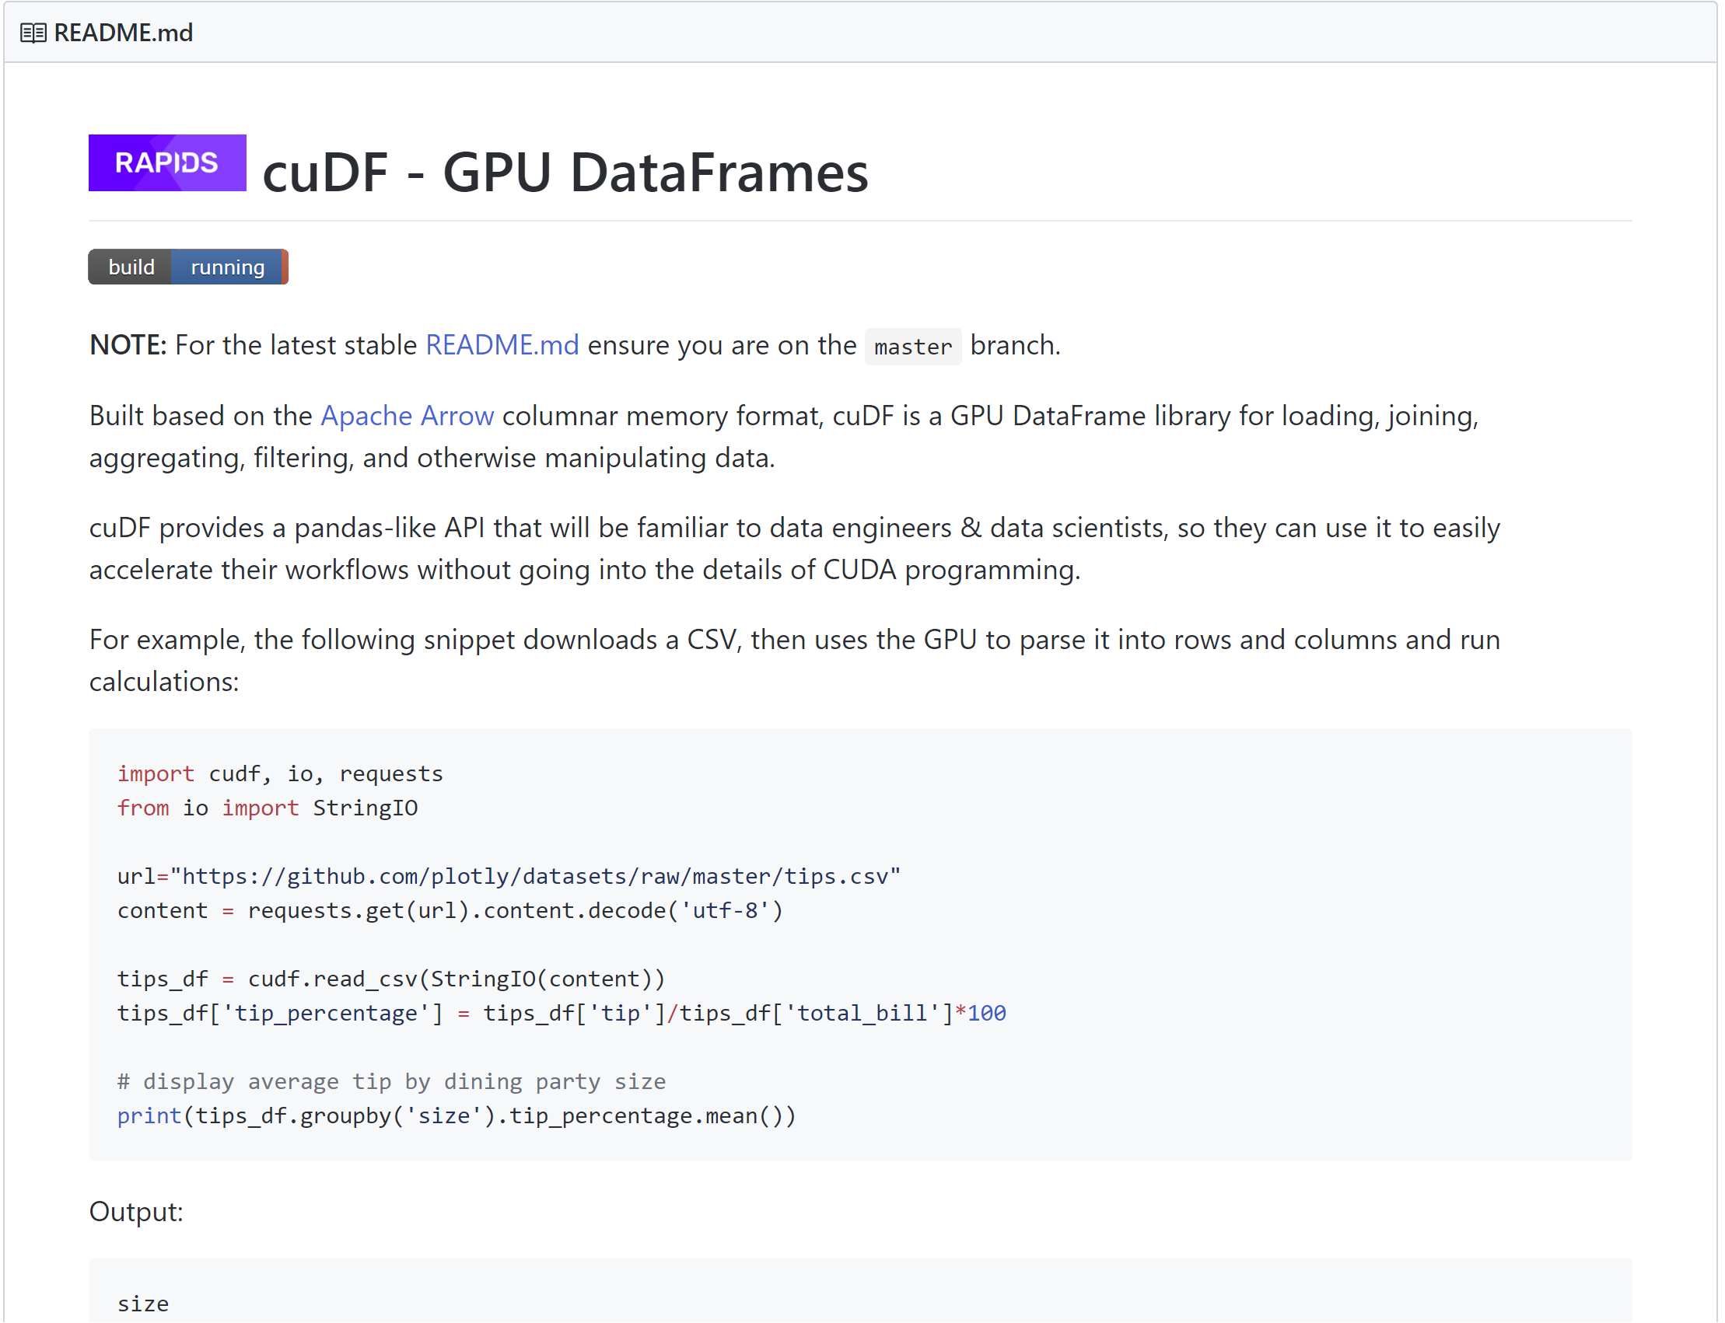
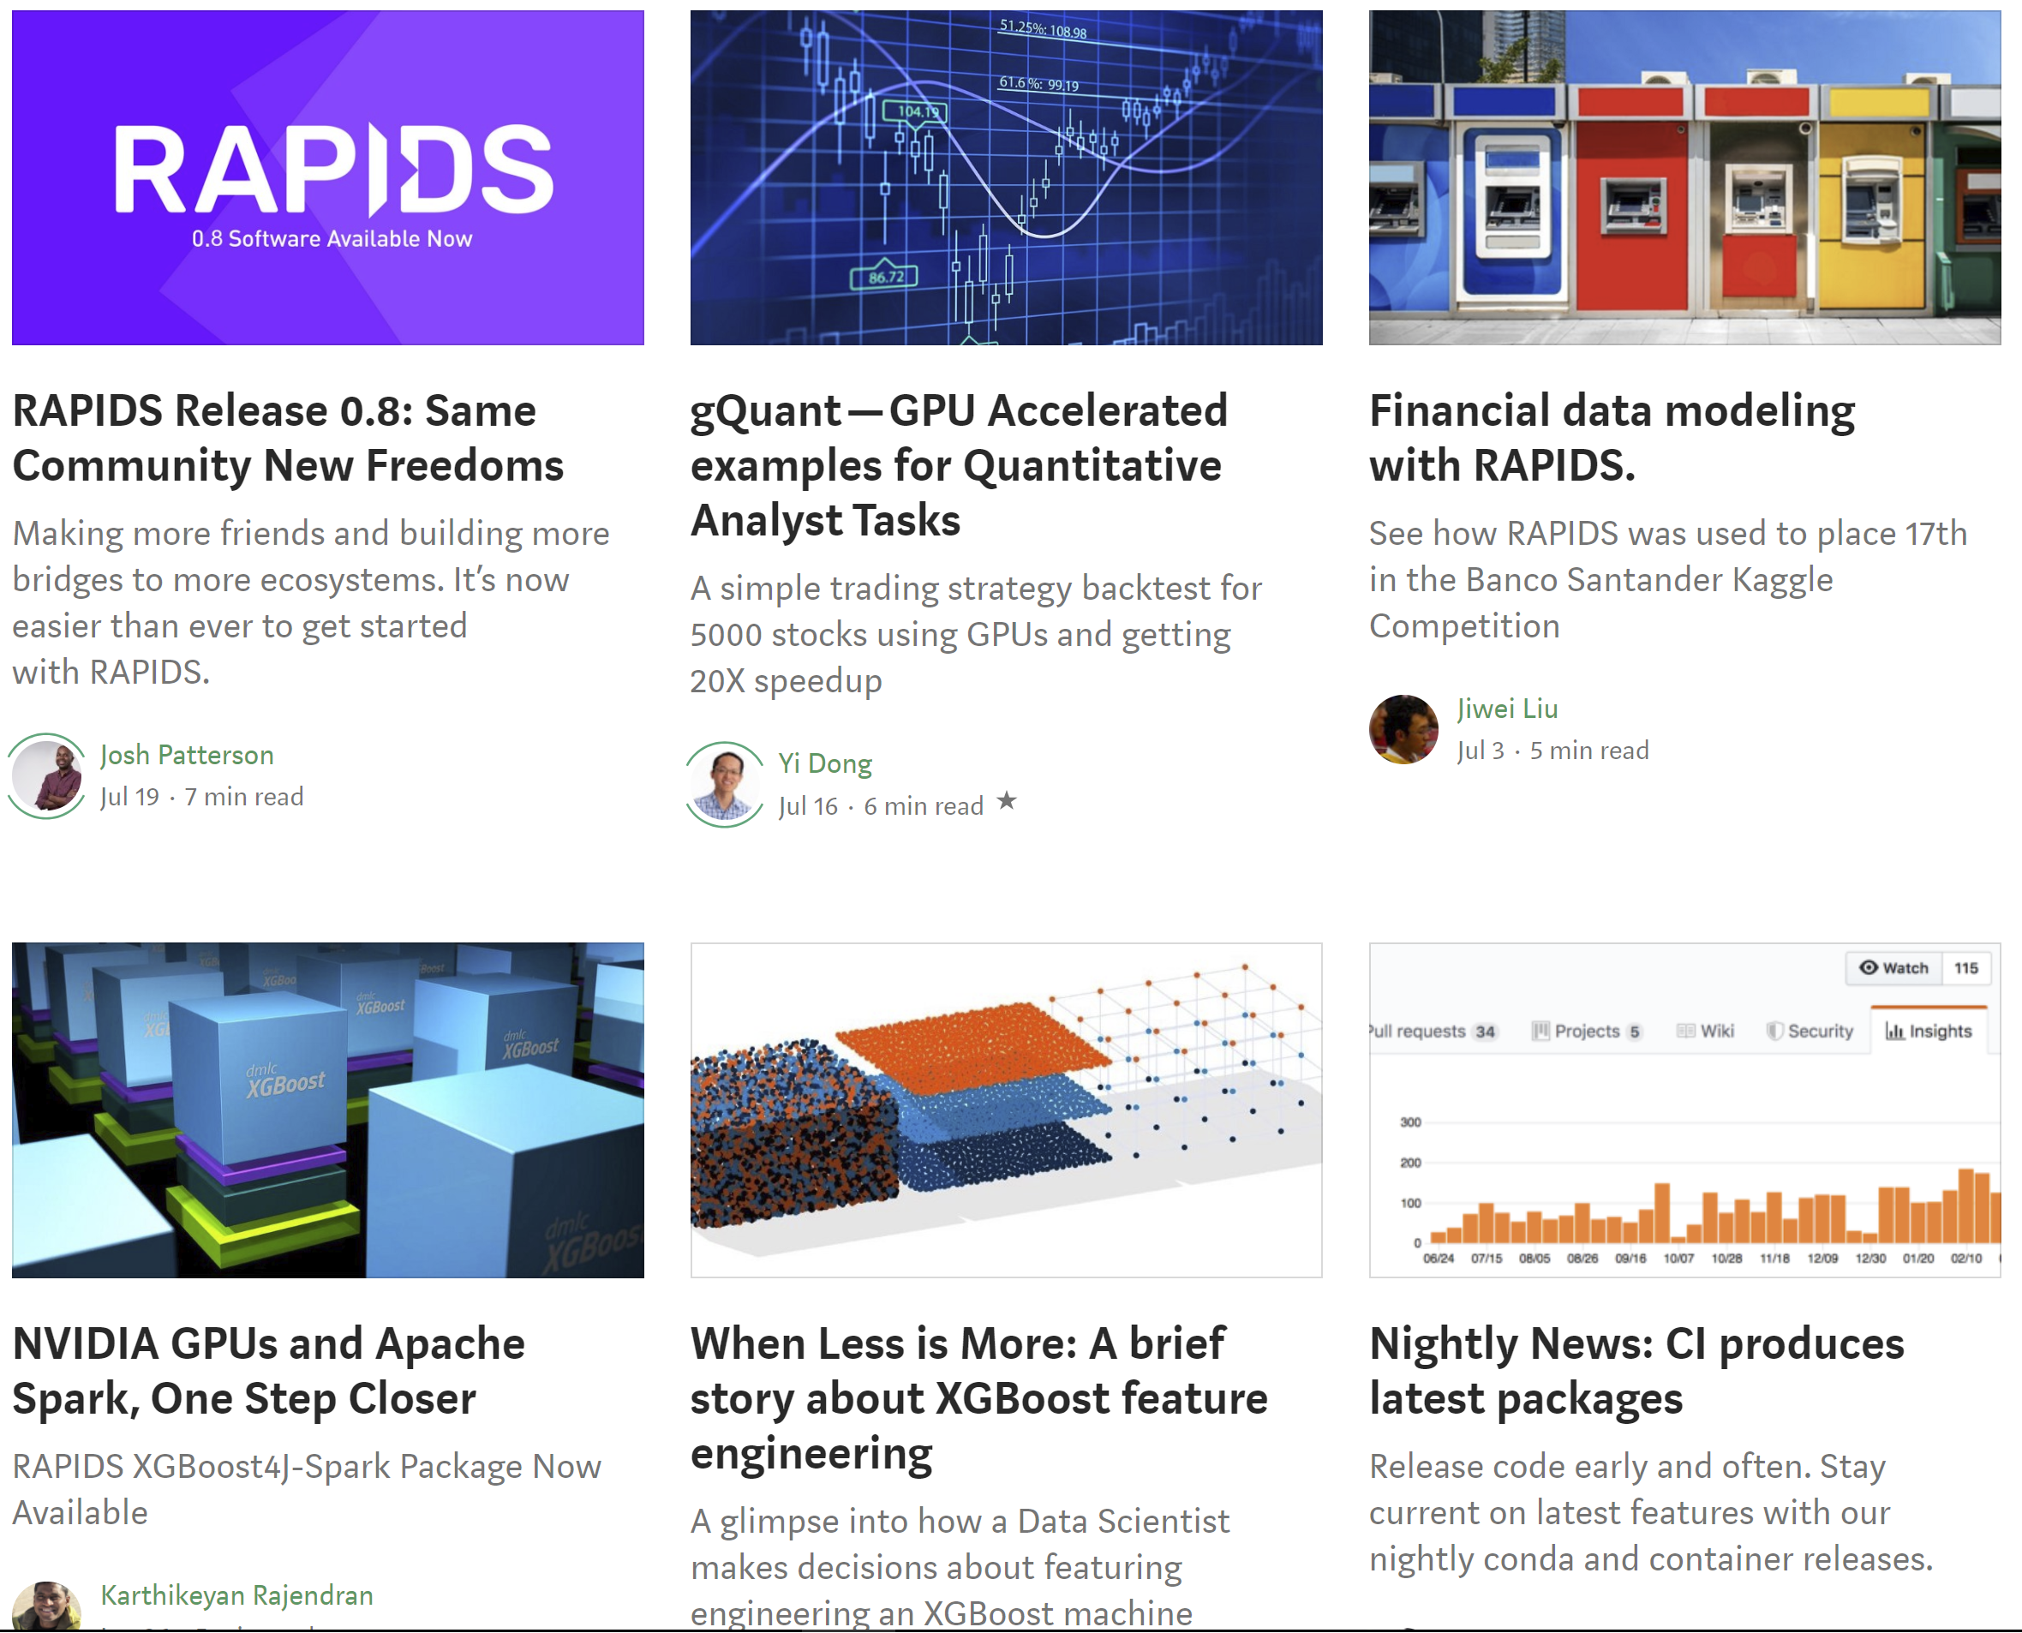
Explore: RAPIDS Code and Blogs
Check out our code and how we use it
https://github.com/rapidsai
https://medium.com/rapids-ai

Slide 67
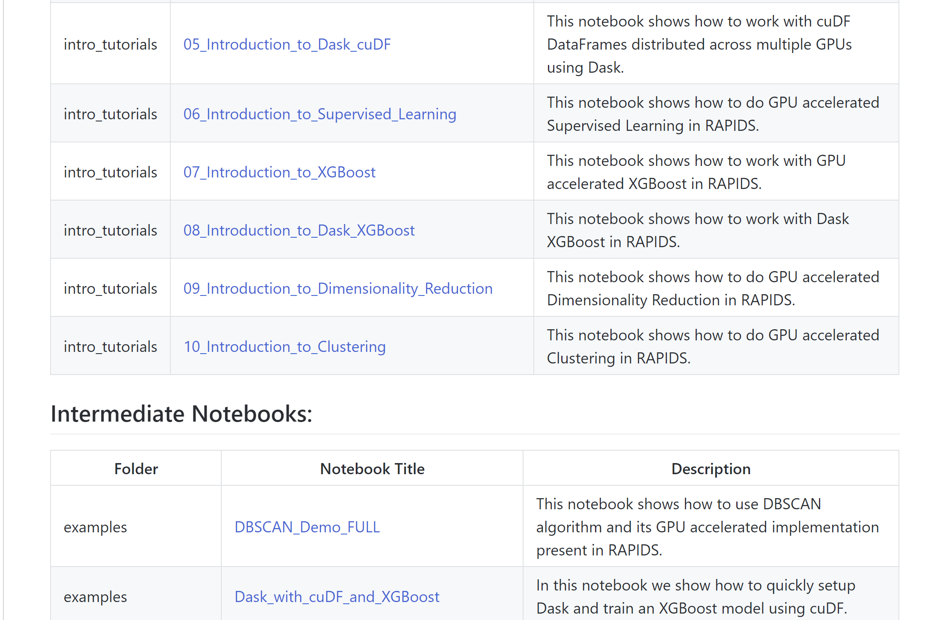
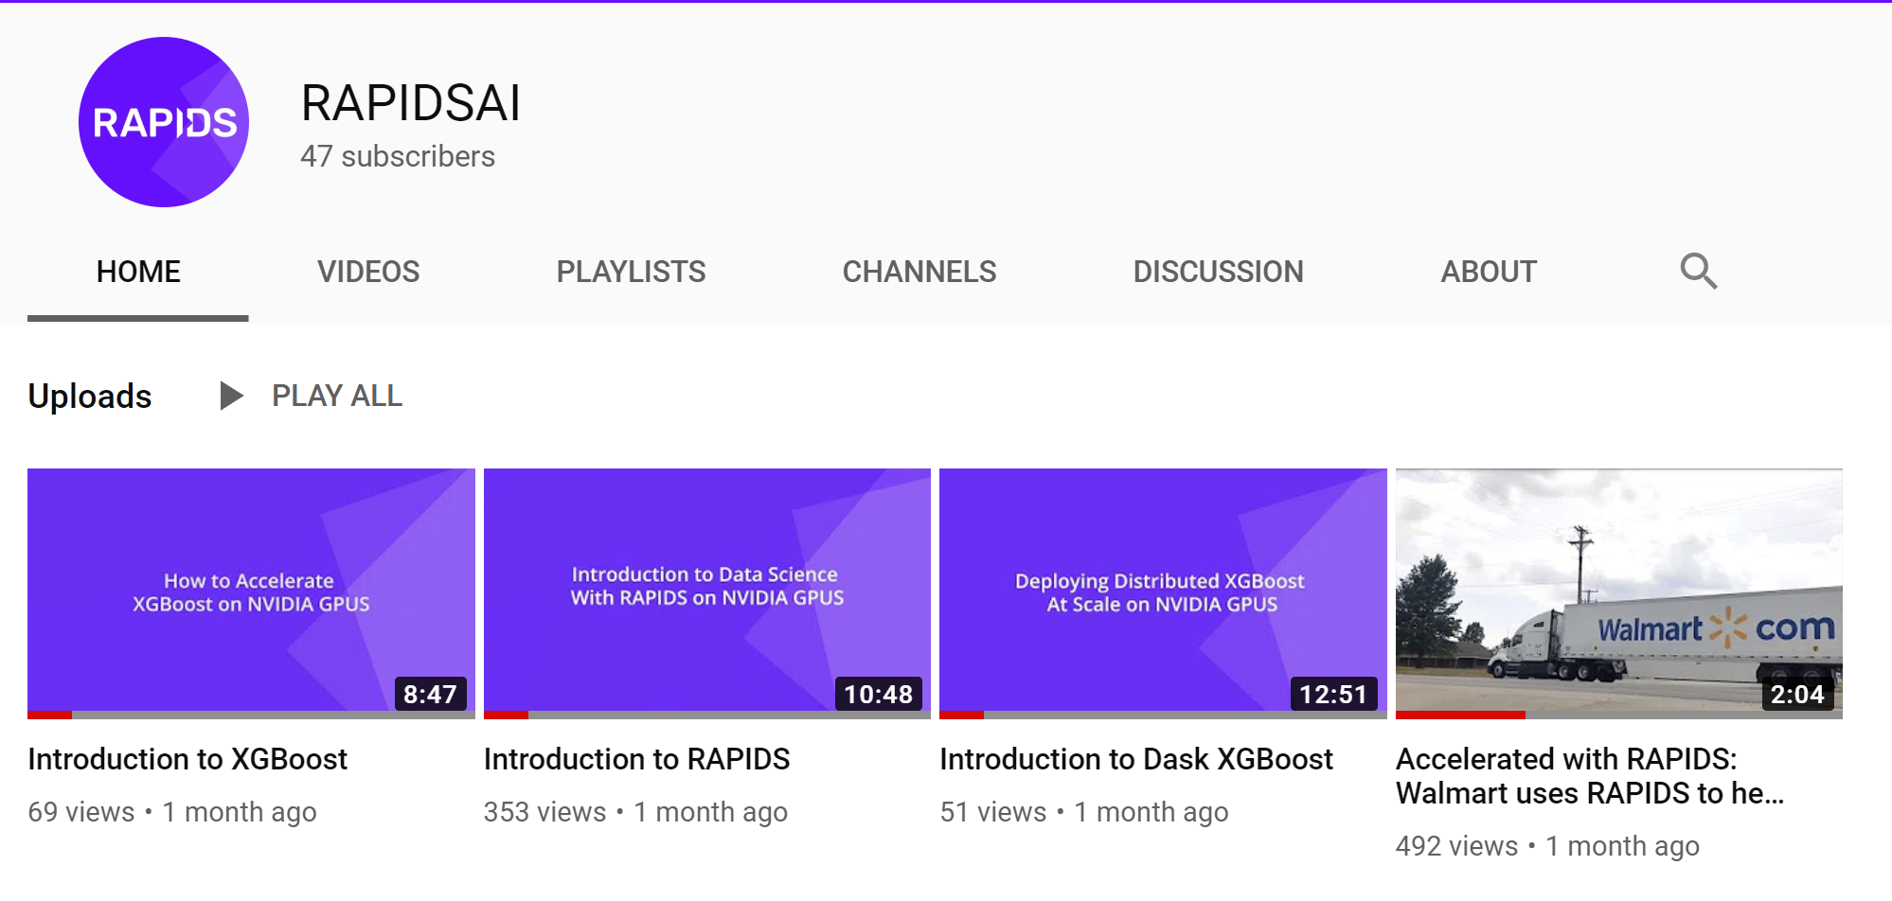
Explore: Notebooks Contrib
Notebooks Contrib Repo has tutorials and examples, and various E2E demos. RAPIDS Youtube channel has explanations, code walkthroughs and use cases.

Slide 68
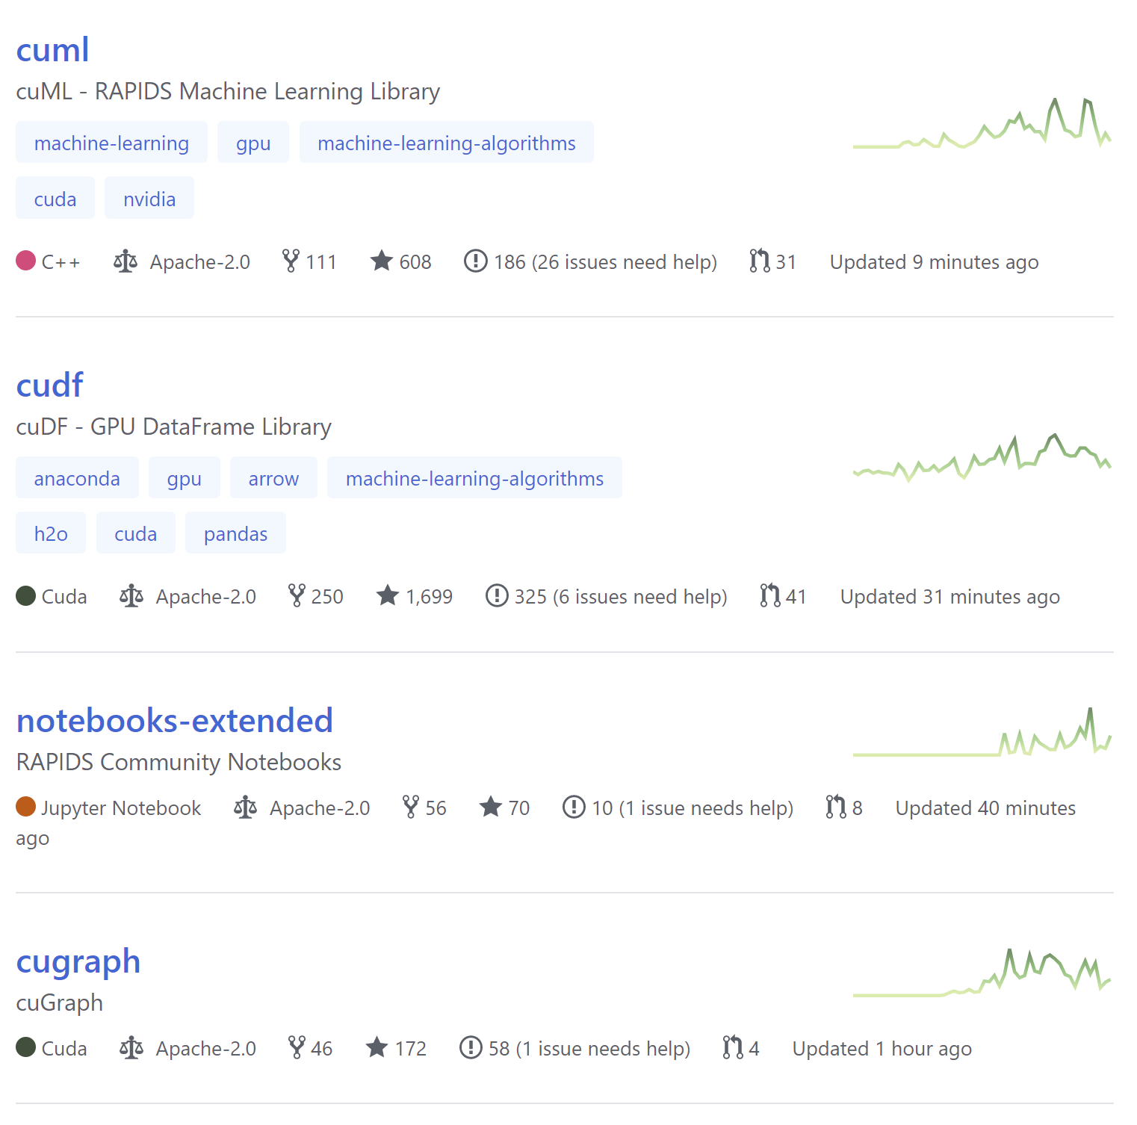
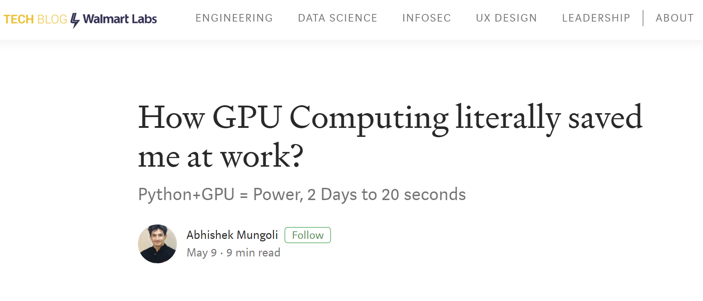
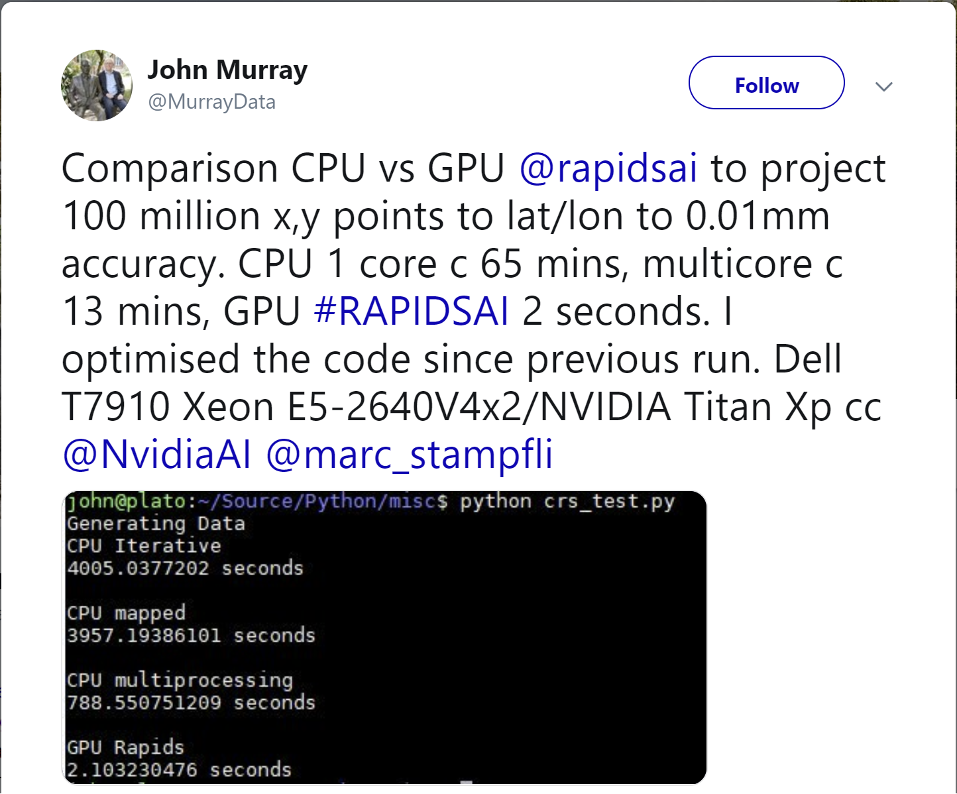

Contribute Back
Issues, feature requests, PRs, Blogs, Tutorials, Videos, QA...bring your best!

Slide 69
Getting Started

Slide 70
RAPIDS Docs
New, improved, and easier to use
https://docs.rapids.ai

Slide 71
RAPIDS Docs
Easier than ever to get started with cuDF

Slide 72




RAPIDS
How do I get the software?
https://github.com/rapidsai
https://anaconda.org/rapidsai/
https://ngc.nvidia.com/registry/nvidia-rapidsai-rapidsai
https://hub.docker.com/r/rapidsai/rapidsai/

Slide 73




Join the Movement
Everyone can help!
APACHE ARROW
RAPIDS
Dask
GPU Open Analytics Initiative
https://arrow.apache.org/
https://rapids.ai
https://dask.org
http://gpuopenanalytics.com/
@ApacheArrow
@RAPIDSAI
@Dask_dev
@GPUOAI
Integrations, feedback, documentation support, pull requests, new issues, or code donations welcomed!

Slide 74

THANK YOU
Joshua Patterson @datametrician
joshuap@nvidia.com

